Slide 1
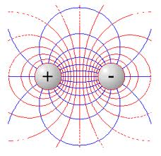
PHY 042: Electricity and Magnetism
Electrostatics
Prof. Hugo Beauchemin

Slide 2
The Maxwell equations
A set of 4 differential equations completely determining:
How charges produce electric (E) or magnetic (B) fields
How the variation of an E (or a B) field generates a B (or an E) field
How the fields affect the motion of charges
Differential form
Integral form
i)
ii)
iii)
iv)

Slide 3
Math we will build on
Vectors are abstract entities describing any object satisfying linear conditions
E.g.:
Vector functions can be differentiated
Divergence and curl
➔ Can write differential equations for vector fields
The derivative of vector functions can be integrated
Can find vector fields by solving differential equations
Charge and current sources determine how a vector field is varying
From a set of boundary conditions, we can fully solve for a vector
field when the sources are known

Slide 4
Problem to solve
We want to understand Maxwell’s equations, so we must learn how the derivatives of electric and magnetic fields are related to charge and current sources
Need to find the exact form of the differential equations and
need to give a physics meaning to the terms in the equation
Approach adopted to achieve this:
Start from a practical physics question based on some observations of E&M phenomena
Conduct experiments to extract/induce physics laws expressing the fundamental structure of the observed phenomena
Define new concepts and use new math to generalize the law and apply its generalization to new experiments and new phenomena

Slide 5
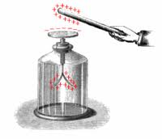
Classical electrostatics
Observations: there is an invisible force between two charged bodies that attract or repulse each other under certain circumstances
➔ Use experiments to quantify the force
between two charged systems
Some experiments historically played a major role in the conceptual development of E&M. They established the context of E&M:
Macroscopic experiments ➔ classical physics
Systems at equilibrium ➔ non-relativistic descriptions
We will realize later that E&M is relativistic…
We thus first only consider electrostatics and magnetostatics
Electric and magnetic fields are decoupled and lead to distinct phenomena

Slide 6
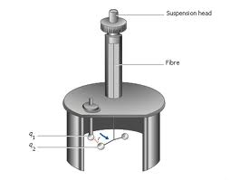
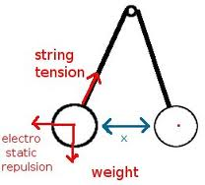
Coulomb’s law
Coulomb’s law is at the origin (after generalization, as we will see) of the first Maxwell’s equation
It is an empirical relationship telling you what is the force two charges are exerting on each others when the system is at equilibrium.
Actual experiment
Idealized experiment

Slide 7
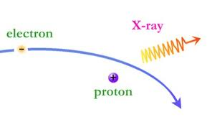
Conditions of applicability
The experimental setup from which the law has been extracted reveals the conditions in which this law applies, i.e. the limits in the applicability of the law:
Charges are kept in fixed positions
Currents would correspond to different phenomena and laws
A mechanical force is used to establish the equilibrium, thus avoiding the acceleration of the charge
Classical physics
This is the underlying physics structure of Coulomb’s law
This structure will eventually be generalized, extending the formula to different situations, experiments and phenomena

Slide 8
Structure of the law I
Q: Can a charge act on itself?
A: It is a force so it must comply with the 3rd law of Newton:
A system can’t moved from action on itself
Q: What happens if q₁ is doubled?
A: The force is doubled
Fundamental element of the structure of the theory:
Superposition principle:
The interaction between any two charges is completely
unaffected by the presence of others
Q: Which formal structure of the law represents this principle
A: The linearity of vectors

Slide 9
Structure of the law II
The superposition principle implies an extra limitation in the condition of applicability of Coulomb’s law:
The experimental preparation and the final instrumental
setup must always be made in such a way that individual
charge elements* contribute to the Coulomb’s force
independently of each others
Other fundamental structure (properties) of the Coulomb’s law:
The force is radial (act on the line from q₁ to q₂)
Does it implies a spherical symmetry?
It is attractive or repulsive (q₁q₂ > 0 or q₁q₂ < 0)
* More details on this next slide

Slide 10
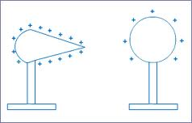
Charge density
We haven’t yet defined what is a charge element:
It can certainly be a macroscopic charged object as in the figure
But, measuring electric attraction/repulsion along the surface of an extended object (left in the figure) might yield variations
➔ Need a definition accounting for
smaller charge elements than a
full object
Charges are not quantized in classical mechanics so we cannot use the charge of the electron as fundamental charge unit
Use the definition of continuity in classical physics (valid for the
description of macroscopic objects) to define charge density
Take the average over a small volume element and over a sufficiently large time period of all possible quantum fluctuations of the system, and assign this average value to all the points inside the volume element

Slide 11
A new object: Electric field
Looking at the form of Coulomb’s law for the effect of various charge densities on a charge q₂, we can rewrite the equation as:
We can see the electric field as a vector field determined by the configuration of a source and its effect on any test charge q₂
A new concept with a different empirical physics content (meaning):
Independence with respect to test charge
➔ there is a physics object, a concrete entity, acting on q₂ and
generating the Coulomb’s force
Coulomb’s force satisfies Newton action-reaction relationship
➔ something get transmitted between two charges in interaction:
The Electric field.

Slide 12
Inheritance from Coulomb’s
Is the electric field fundamentally different than the Coulomb’s force? Are they fully correlated and interchangeable concepts or something get added to the concept of electric force?
Structures inherited from Coulomb’s force :
The situations in which these concepts apply are so far the same:
Electrostatic systems created by a fixed charge distribution
Systems at equilibrium
➔ The empirical structure of the Coulomb’s force restricts, for the
moment, the applicability conditions of the concept of electric field
The empirical meaning of the electric field is given by the capacity to measure everywhere the electric force of a charge distribution on q₂
What is so static about the first Maxwell’s equation???
A generalization is needed to go from Coulomb’s to Gauss
Remember, two equations must be specified to determine a field…

Slide 13
Fundamental difference
There is a nevertheless a fundamental difference between the Coulomb’s force and the electric field: the test charge
The test charge must not disturb the position, the
velocity or the charge distribution of the source
That creates an asymmetry between test charges and source charges which is NOT in Coulomb’s law
The test charge can change the field elsewhere (superposition principle), but must not affect the source:
The test charge must be kept fixed by some strong mechanical effect
It must be much smaller than the source charge
The test charge is thus responsible for:
The empirical meaning of the electric field (how we know the field exists)
A small but fundamental difference between the force and the field
The possibility to extend the concept of E-field to many new situations

Slide 14
Advantages of the field concept
The concept of electric field is the key to generalization:
An empirical formula becomes a set universal equations
A global description of a system is replaced by a local description of the system
Expresses the physics laws in terms of differential equations
The system of equations formalizes the statics conditions and thus provides the way to yield an adequate description of non-static systems
Non-zero curl of E will lead to non-static cases
The concept can describe experiments for which Coulomb’s law wouldn’t apply, ultimately without carrying its limitations
The electric field is an object, an entity and this will become more obvious in electrodynamics: radiation
The electric field is more than just a simple reformulation of the Coulomb’s law and this is why we introduce the concept

Slide 15
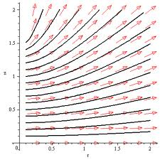
Field Representation
Two complementary ways to represent electric fields:
Vectors at various space points
Represent well the norm and direction of the field at various points
Tangent lines of field
Show the continuity of the field
Allow to well represent lines of equipotential (normal to field lines)
Still see the magnitude of the field from the density of line
Conventions:
Lines from + to –
Lines spaced fairly at equal field
Lines don’t cross

Slide 16
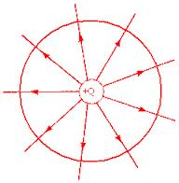
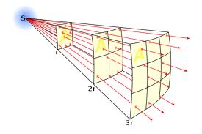
Gauss’ law: the intuition I
Gauss’ law clearly shows that the electric field brings something more in the first Maxwell’s equation than what is in Coulomb’s law
F=qE cannot be written as a resolvable diff. equation
Q: How can we generalize to ?
A: Use a fundamental structure of Coulomb’s law,
the 1/r² behavior of the law, and use
the flux-divergence theorem
Why is this 1/r² behavior so critical?
Density of lines in decrease as 1/r²
Area of closed surface increase as r²
These quantities are related in the flux
Field line representation
➔ The flux of E-field through a closed surface is constant!

Slide 17
Logical steps to follow
We now need to formalize the previous statement and demonstrate its complete generality in electrostatics
To reach such generalization (the Gauss’ law) we need to:
Use the 1/r² behavior of Coulomb’s law for a point charge to determine what is the value of the constant electric field flux that is passing through a surface S enclosing this point charge;
Specify to which surface S this law can apply;
Specify the conditions in which this law is true;
Understand what is added to the Coulomb’s law by the new law.
➔ This generalization leads to one of the most fundamental
law of physics
Let now study each of the above points step by step

Slide 18
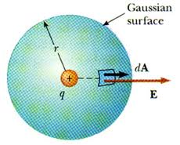
What is the constant value of the flux?
The flux is a measure of the number of field lines that are passing through the surface S
It is given by:
This density of field lines is related to the quantity, in the E-field, which is responsible for the strength of the field at any P(x,y,z)
➔ Total electric charge times
possibly some constants
Let check it for the flux of a point
charge through a spherical surface at
the origin of the coordinate system:
The constant value of the flux!!!

Slide 19
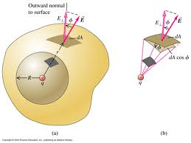
To which surface does it applies?
We want to find out if the above result is only valid for a spherical closed surface or if it can also apply to some other Gauss’ surfaces.
The flux through a close surface not containing any charge is null: each external field incoming line, also gets out of the closed surface
We already showed that the q/ε₀ result is valid for a spherical Gauss’ surface
We can split any surface as a sphere containing the charge and the rest of the surface with an hollow sphere, the charge being outside
➔ The constant flux applies to ANY closed surface

Slide 20
Gauss’ law
By the superposition principle, the above result is valid not only for a point charge, but for any charge distribution
the law depends only on the total charge enclosed in the surface
Gauss’ law:
The flux of an electric field through ANY closed surfaces S is given by the total charge, constant, enclosed in that surface
And using Flux-divergence theorem:
We reached the first Maxwell’s equation!

Slide 21
Conditions of applicability
We exploited the 1/r² nature of the Coulomb’s law to derive Gauss’ law. The empirical conditions of this law are therefore the same as for the Coulomb’s law
➔ Static charges in classical systems at equilibrium
Although Gauss’ law applies to ANY closed surface, it is only useful in experiments (problems) with symmetries to be exploited
The FLUX is independent of S, but the ELECTRIC field is NOT.
The E-field depends on the charge distribution ρ enclosed in S. Gauss’ law can only be used to find it if ρ has symmetries that allow to bring E out of the integral. Like for Coulomb’s law, ρ must be known.
Asymptotically, the charge distribution becomes irrelevant and can be considered as a point charge
Will be proved later…

Slide 22
What does it add?
While the Gauss’ law inherits of a similar domain of applicability as the Coulomb’s law, it nevertheless constitutes an extension because:
It can be applied to any electrostatics system at equilibrium, and not just to Coulomb’s like experiments
E.g.: Capacitors, E outside sources, etc.
The electric field is not anymore expressed as the global effect of the equilibrium of a full system, but rather as the effect of a charge distribution on a point and its vicinity
This is an extra structure added by the Flux-Divergence theorem
➔ Differential equation
Outside the source, the field is now well defined:
Still need the curl of the electric field to get a complete knowledge of the electric field, as guaranteed by Helmholtz’ theorem
Have to possibility to take it non-zero and extend to electrodynamics

Slide 23
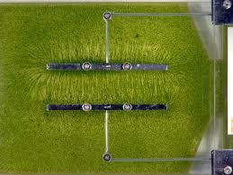
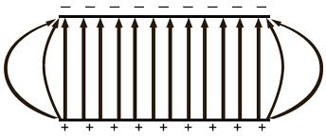
Applications
First focus on the integral form of the law (closer to Coulomb)
By choosing a Gauss’ surface S that features the symmetry of the charge distribution, we can significantly simplify a problem
Often consider long cylinder or large plane to exploit cylindrical or planar symmetries
In realities, side effects are often important to account for, but are difficult in Gauss’ formalism
Can use the superposition principle to decompose a distribution into more symmetric elements

