Slide 1
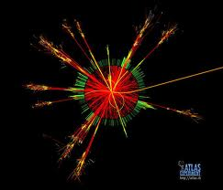


Experimental search for Quantum Gravity
News from the ATLAS detector at the LHC
Prof. Pierre-Hugues Beauchemin
Thu Oct 25th 2012
Tufts University
On behalf of the ATLAS Collaboration

Slide 2
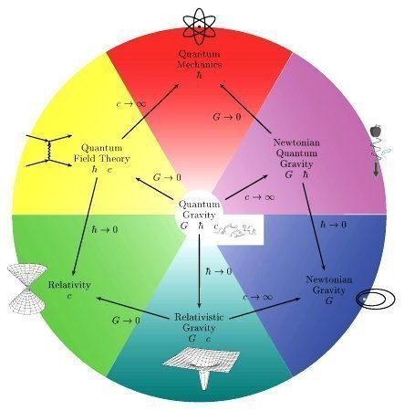
Context
Need to understand
From the physics that
can describe
Take some fundamental ingredients of a QG theory
Import them into QFT
  Write effective theory
  Complement it with pheno. models
Make predictions
Test and interpret results
New physics scale must not suppress new effective lagrangian terms below testable limits otherwise the exercise is irrelevant…

Slide 3
Quantum gravity @ LHC
To be testable at the LHC, the scale at which the QG structures become important must be O(TeV)
➔ Some extra dimension structures replace suppression of gravity state
couplings to SM fields by powers of M_{Pl} with some scale Λ~TeV
Two scenarios (a rich phenomenology) are tested at the LHC:
  ADD scenario of large extra dimension:
    Direct production of gravity states
    Virtual graviton KK-tower exchange
    Transplanckian scattering phenomena
      Mini Black Holes, String Balls
  RS wraped extra dimension scenario:
    Virtual massive graviton exchange
There could possibly be other structures that can give testable predictions
➔ signature-based, model-independent searches

Slide 4
What to take from this?
Often constrains are only set on toys or not up-to-date models
Does it matter? Let’s take a pragmatic approach:
  Yes: large efforts are deployed by both communities to make sure latest ideas are properly tested in their kinematic regions of interest
  And… not so much: analyses are made as model-independent as possible and limits on benchmark models simply give an example of interpretation
    Benchmark results needed, as there will always be untested models
    Benchmark models often get the bulk of the relevant constraints on some ideas
➔ Won’t try to list the constraints that could be set by LHC on all
possible QG models, but refer to small list of benchmark models
Objective: present the assumptions and the conditions of applicability of the constraints set at the LHC on benchmark models relevant to QG
➔ will tell what can be reused and where you have to be careful in
interpreting our results into your favorite scenario

Slide 5
QG@LHC’s Benchmarks
Minimal ADD and RS models offer good benchmarks because:
  simple, ie low number of parameters, generic kinematics
  models are well understood by all
  simulations are available to both communities;
  contains features reused in many other models,
    Eg: Z’, excited quarks, etc
  Often the theoretical differences with more thorough models only yield small differences in the experimental observables
  ➔ easy to be reused to constrain your favorite model
Systematically used from experiment to experiment, allowing for robust comparison of different experimental results and appreciation of the progresses made

Slide 6
Overview of analysis
Same model tested in various final states
  A non-tested model can suppress a signature
    Leptophobic resonances
Same final states tested sensitive to various models
  Signature-based/model-independent searches
Choose to present in function of models:
Direct graviton production:
Monojet
Monophoton
Virtual KK-tower graviton exchange:
Non-resonant dilepton
Diphoton
Semi-Classical black holes/string balls
High mass multi-object
Same sign dimuon
Randall-Sundrum:
Diphoton resonance
Dilepton resonance
Model-independent resonance:
Dijets
Gamma-jets

Slide 7
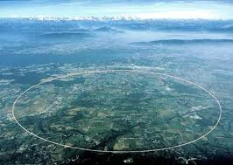
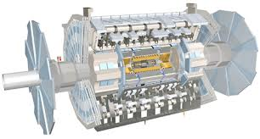
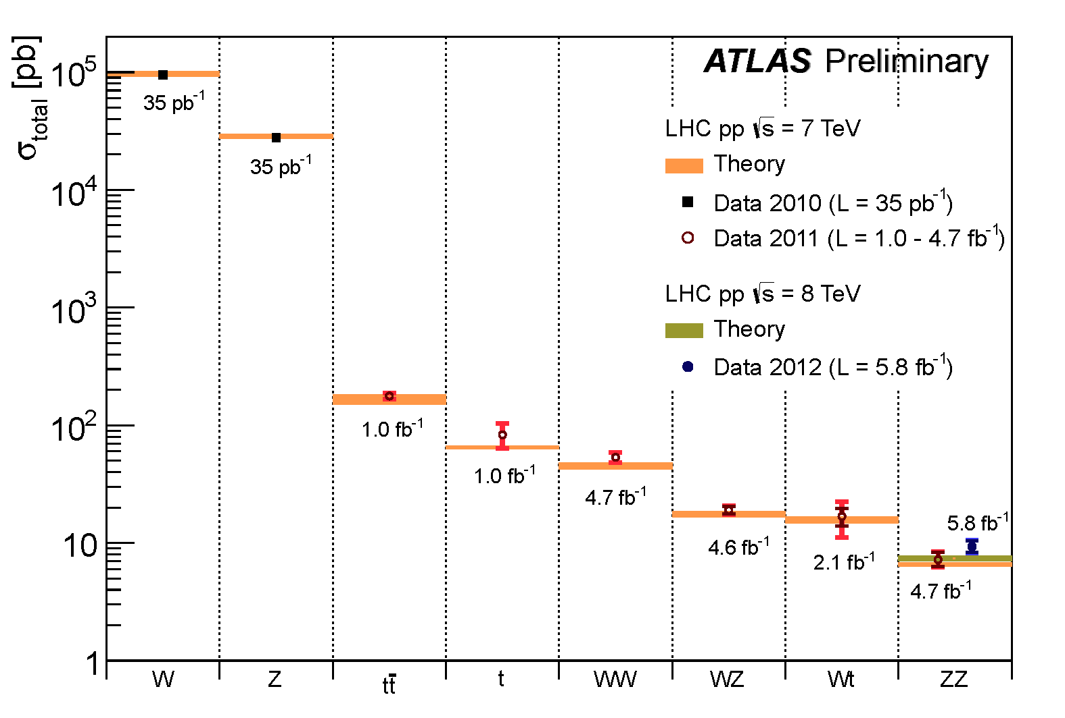
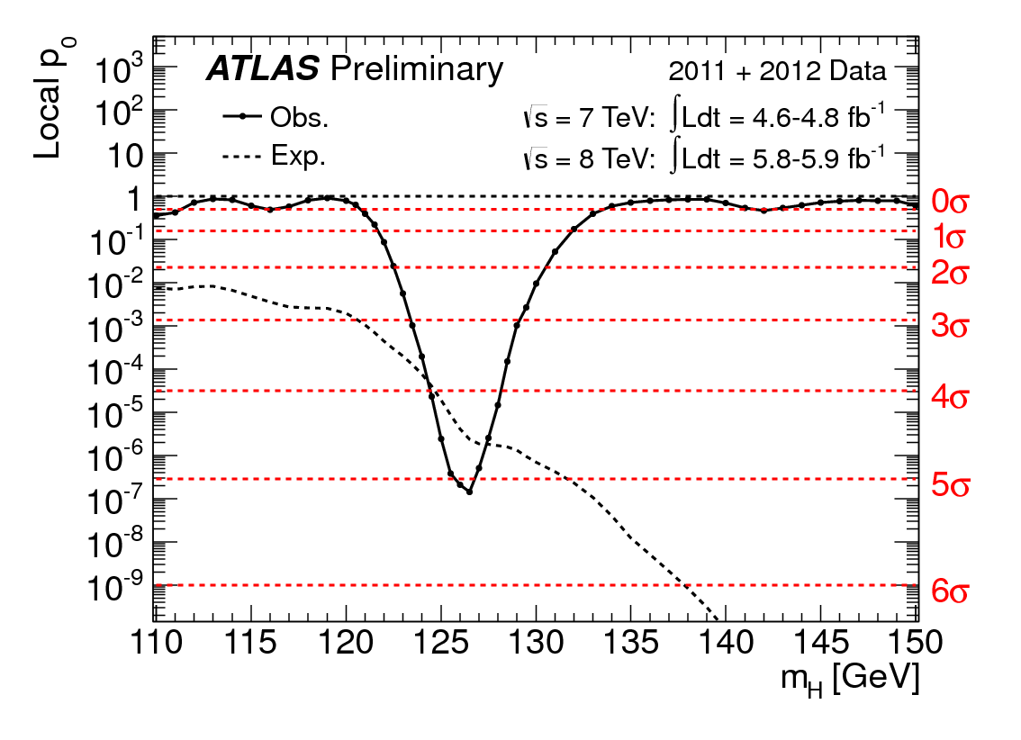
ATLAS at the LHC
The LHC is taking a lot of data
  5 fb⁻¹ (7 TeV), 17 fb⁻¹ (8 TeV)
    Still taking 8 TeV data
ATLAS show these data are widely understood:
  Found the “Higgs”
  Precise SM measurement
➔ Set the ground for discovery

Slide 8
Randall-Sundrum

Slide 9
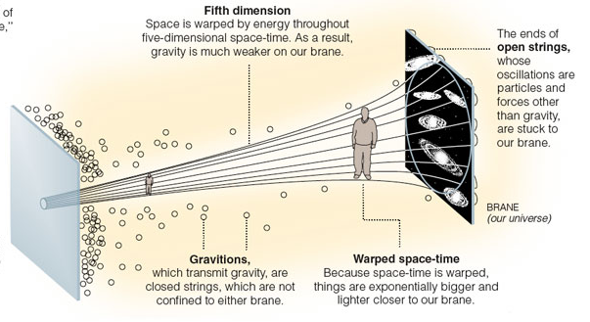
Model assumptions
A compactified spatial extra dimension extends between two branes in wraped geometry
  Wave function of SM field localised on one brane
  Gravity localised on the other brane, but propagate into the bulk
  Gravity scales in one brane related to the other by:
  (k being the curvature of the extra dimension)
  With kr_{c}~12, M_{D}~1 TeV
Compactification of extra dim gives rise to tower of graviton KK-mode
  Graviton ΔM_{KK} ~ 1TeV
  ➔ Look for resonances

Slide 10
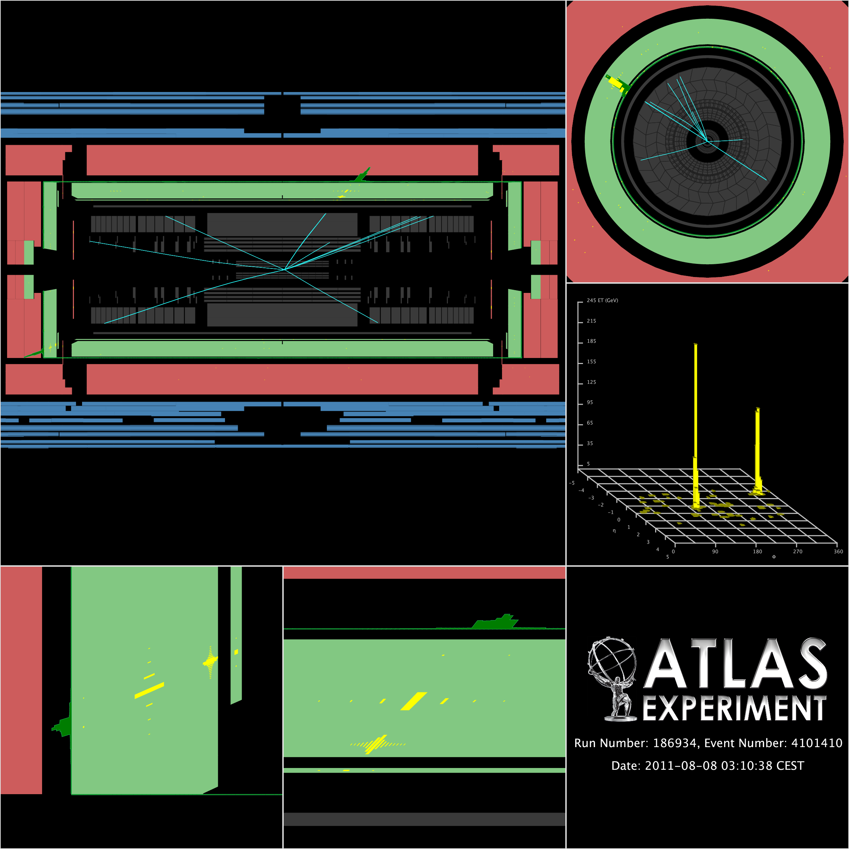
Diphoton search (I)
Very good sensitivity:
  Clean experimental signature, low bkg, very good mass resolution
  Branching fraction is 2x larger than for lepton pairs
    Model-independent
  Can’t be spin-1 resonance
4.9 fb⁻¹ with √S=7 TeV
ATLAS-CONF-2012-087
Combination of MC-based estimate normalized to data, and data-driven estimate
  γγ bkg: MC used for shape, normalization in data low Mγγ region
  jet+gamma/jet: shape from CR (loose gamma), extrapolated to high mass by a fit of

Slide 11
Diphoton search (II)
BumpHunter algorithm is used to scan through the mass distribution between 409 and 3000 GeV
  Look for most significant deviation from null hypothesis,
  Use window mass of progressively increasing width
    From 2 bins, to N/2 bins
  Largest deviation = smallest probability of coming from bkg fluctuation
  Algorithm accounts for “look
  elsewhere effects”
Biggest excess from bkg only
hypothesis: Mγγ in [1312,1644]
86% of the chance of having
larger excess from background-
only hypothesis

Slide 12
Limits on RS
Signal experimental uncertainties: 9.1%
  5%-10% uncertainty on signal yield
95% C.L. limits on M_{G} for various k/M_{Pl}
  Assume 1.75 K-factor

Slide 13
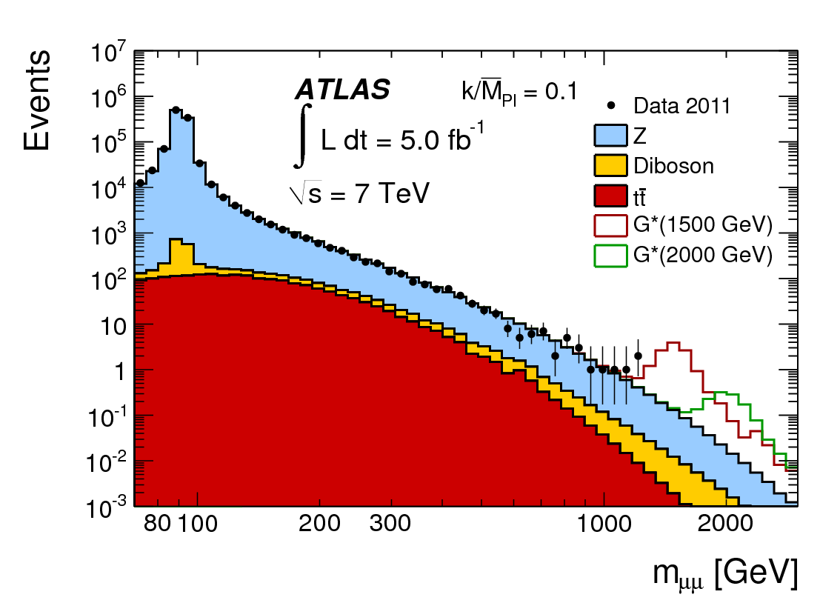
Dilepton
arXiv: [hep-ex 1209.2535]
Narrow high mass resonance search in ee and μμ channels
  Charge ignored to avoid systematics from charge misID
  4.9 fb⁻¹ of 7 TeV data
Background predicted from MC except QCD
  NNLO to LO K-factor estimated in function of M_{ll}
  Weak K-factor also applied to Drell-Yan
  Normalized to data under Z-peak
    Within 1% of unity
    Control systematics
  Theory dominate systematics

Slide 14
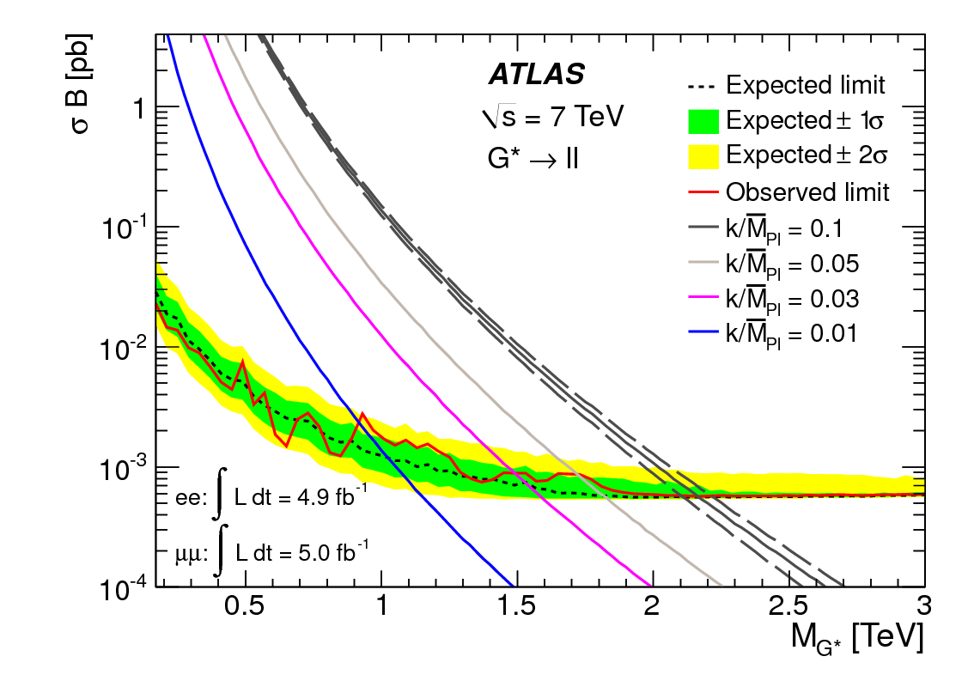
Limits on RS
Signal acceptance (M_{G}=1.5 TeV) = 69% (ele), 44% (muon)
  Independent of M_{G} above 600 GeV
At such masses, interference of signal with Z/γ* is neglected
No K-factors applied to signal
Data are consistent with SM hypothesis
  P-value ele: 54%;
  P-value muo: 24%
Coupling (k/M_{Pl}) | 0.01 | 0.03 | 0.05 | 0.1
Mass limit [TeV] | 0.92 | 1.49 | 1.72 | 2.16
Coupling (k/M_{Pl}) | 0.12 | 0.14 | 0.17 | 0.2
Mass limit [TeV] | 2.23 | 2.32 | 2.42 | 2.51

Slide 15
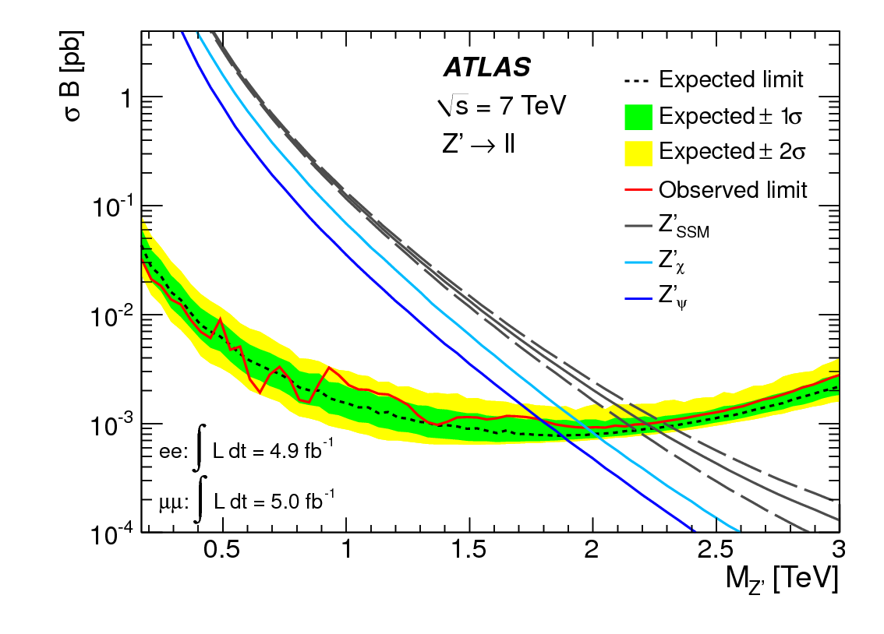
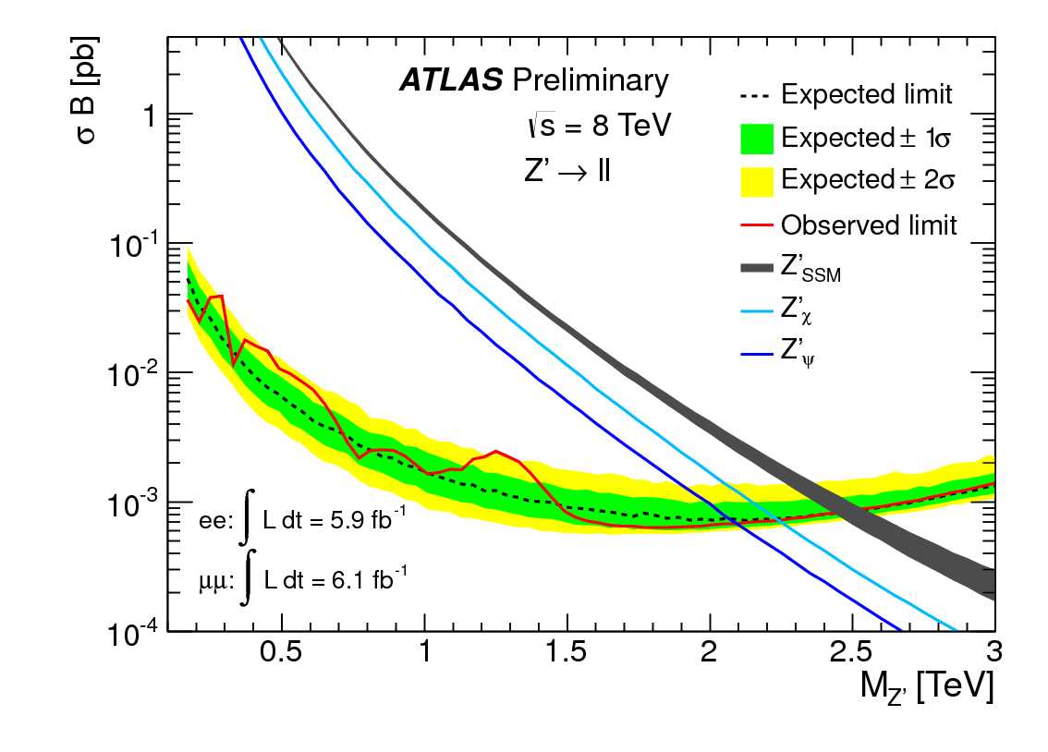
…and at 8 TeV
New results with a different dataset
  6.1 fb⁻¹ of 8 TeV data
  No interpretation in terms of RS, but can nevertheless have a feeling for the limits by looking at Z’ limits
A 2.5 TeV Z’ has x2 higher cross section at 8 TeV than at 7 TeV
ATLAS-CONF-2012-129
Z’ limits for 7 TeV data
Z’ limits for 8 TeV data

Slide 16
ADD

Slide 17
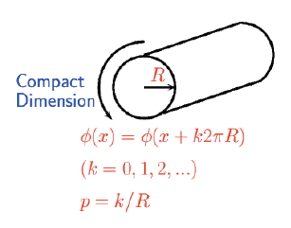
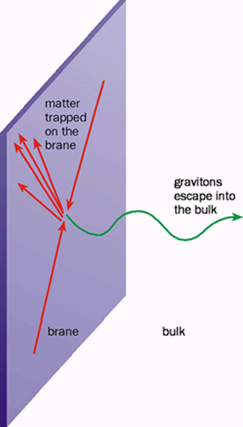
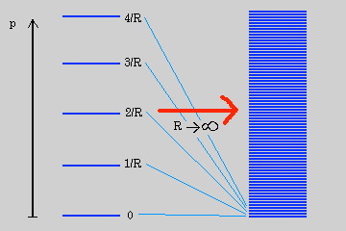
Model assumptions
Limits assume extra dimensions are flat and compactified on n-dimensional torus
  SM fields attached to a 3-brane
    Brane deformation ignored
  Continuous KK-spectrum is assumed, even for n=6
    Universal couplings of each modes
    Assumed the spectrum stops at M_{D}
Fundamental to effective scale relationship:
Prediction from minimal graviton emission model of GRW
  Valid: E<<M_{D}; Pert. exp. break: E>7M_{D}

Slide 18
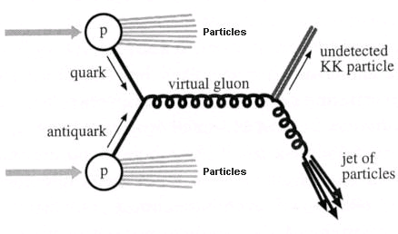
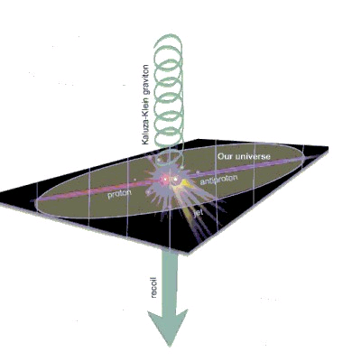
Experimental signatures
Direct graviton production in association with partons or photons
Graviton interaction with
detector suppressed by M_{Pl}⁻²
➔ Missing transverse energy
Signature at the LHC
  Monojet
    More jets due to QCD radiation
  Monophoton

Slide 19
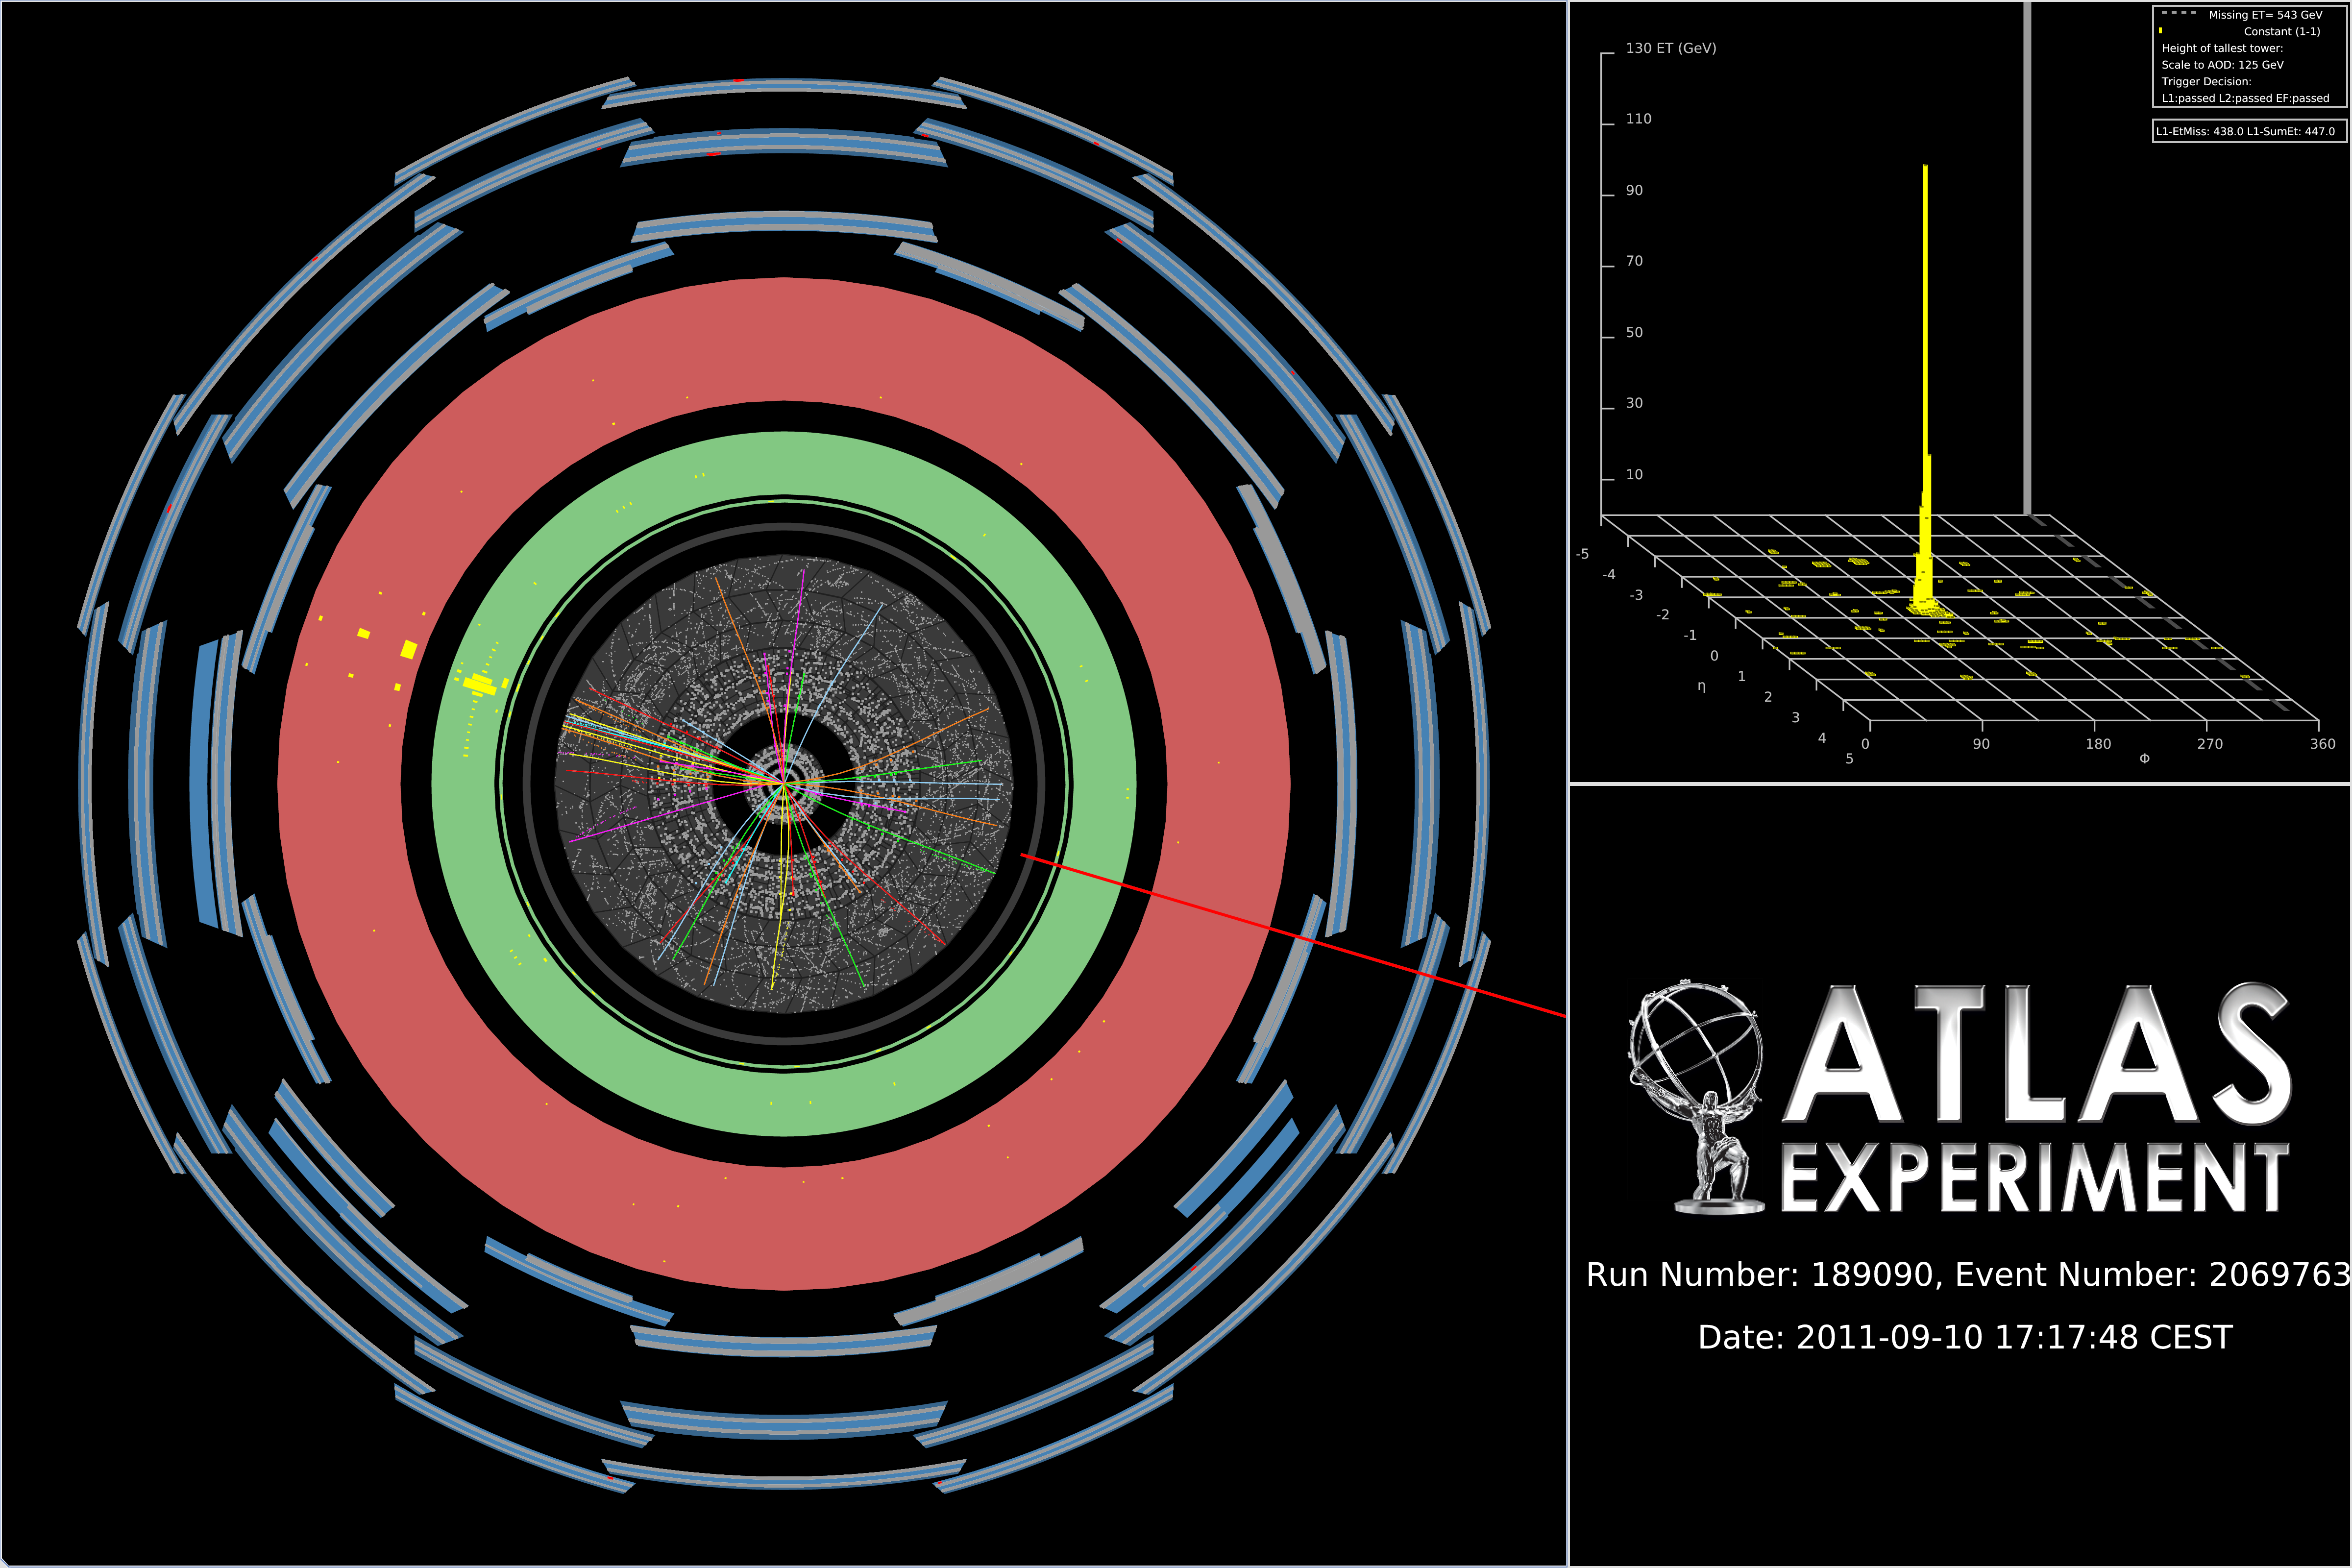
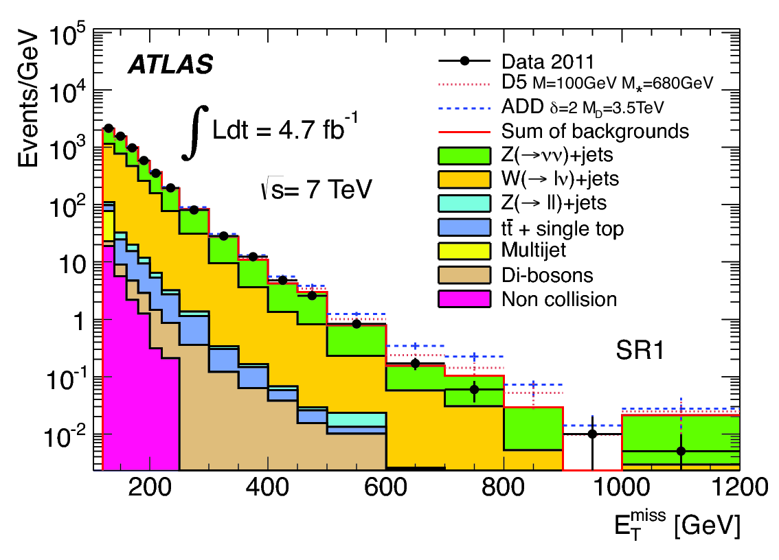
Monojet search
ATLAS: 7 TeV, 4.7 fb⁻¹ of data
Essentially fully data-driven predictions
  Amazing 3.2% precision in high stats region
Prediction in various kinematic regions (~model-independence)
arXiv: [hep-ex 1210.4491]
No excess over SM expectations in any kinematic region

Slide 20
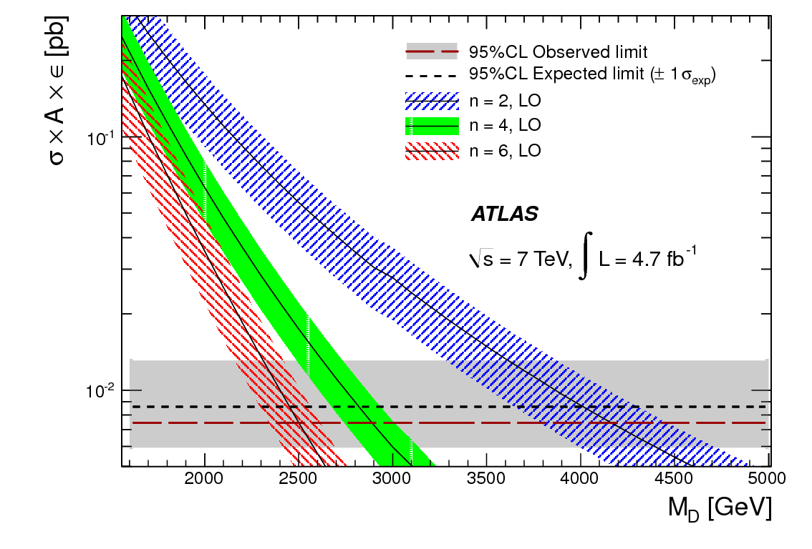
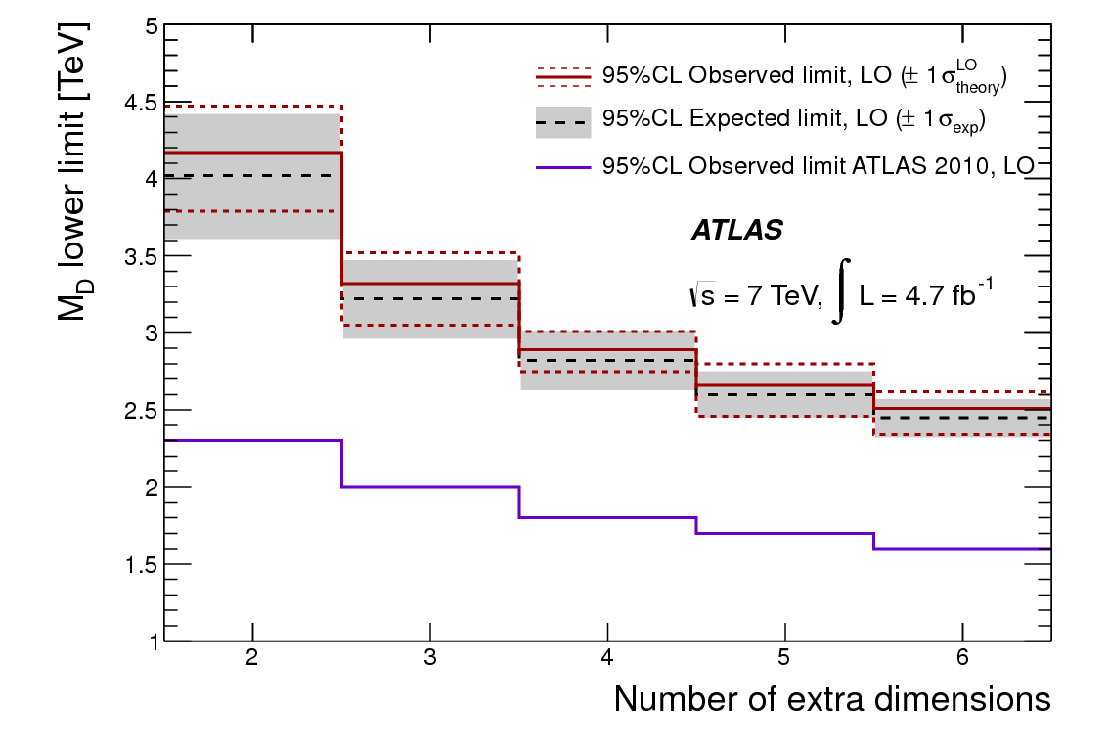
Limits
Typical efficiency for jets and Met selection: ~83%
  Similar for Zvv, and ADD and general dark matter model
Set 95% C.L. limits on M_{D}
  Truncation: quantify UV effects not modeled by L_{eff}
    Δσ/σ = 0% (n=2), 6% (n=3), 20% (n=4), 45% (n=5), 60% (n=6)
  ➔ model does not make non-ambiguous predictions with SR4
    Limits of SR1 to SR3 are 35%, 15%, 5% worse, but less UV sensitive

Slide 21
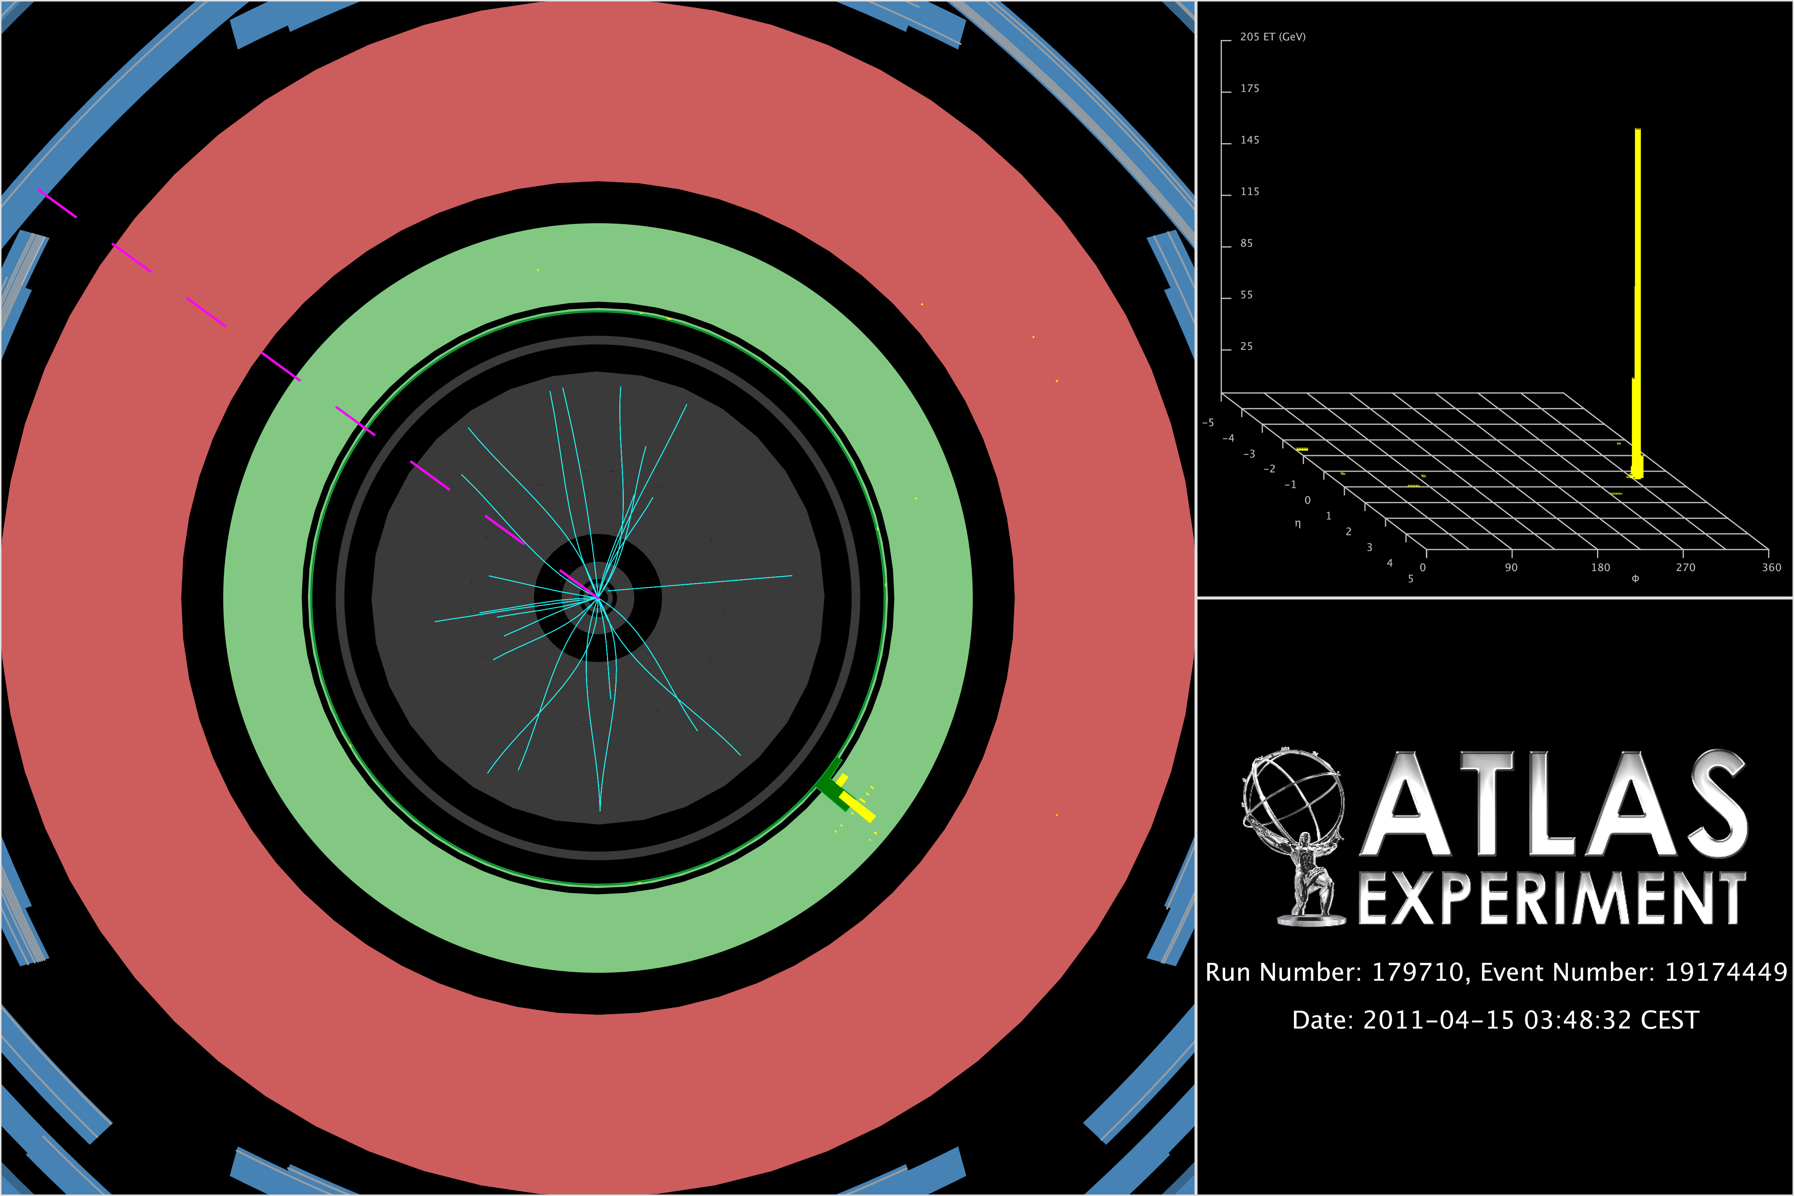
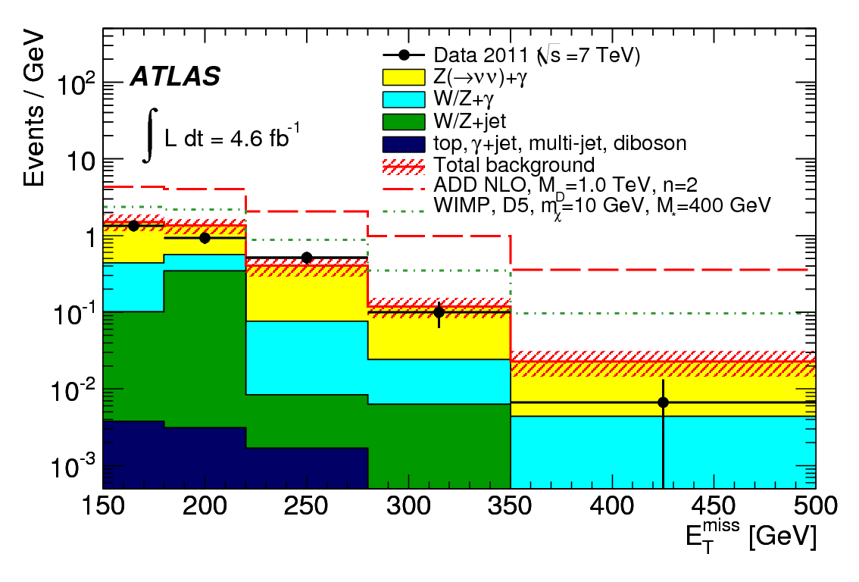
monophoton
arXiv: [hep-ex 1209.4625]
ATLAS: 7 TeV, 4.6 fb⁻¹ of data
Prediction from Alpgen and Sherpa MC normalized in hybrid W+γ/Z+γ data control regions
  Electron and jet fake rate estimated from data
Statistics limit the use of data-driven, but MC more reliable for QED than for QCD
Data agreement
with SM predictions

Slide 22
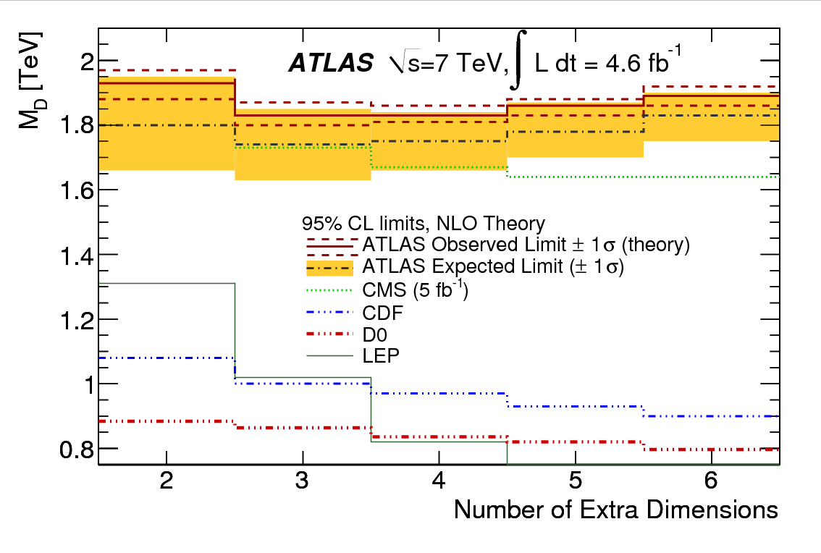
limits
Signal; A x ε ~20%
  Independent of M_{D} and number of extra-D
  Also tested on generic dark matter model: vary between 18% and 23%, with only a small dependence on WIMP mass
95% CL limits on:
  σxAxε = 6.8 fb-1
    Axε ≈ 20 ± 1%
    NLO cross section used
Limits are almost
independent of n

Slide 23
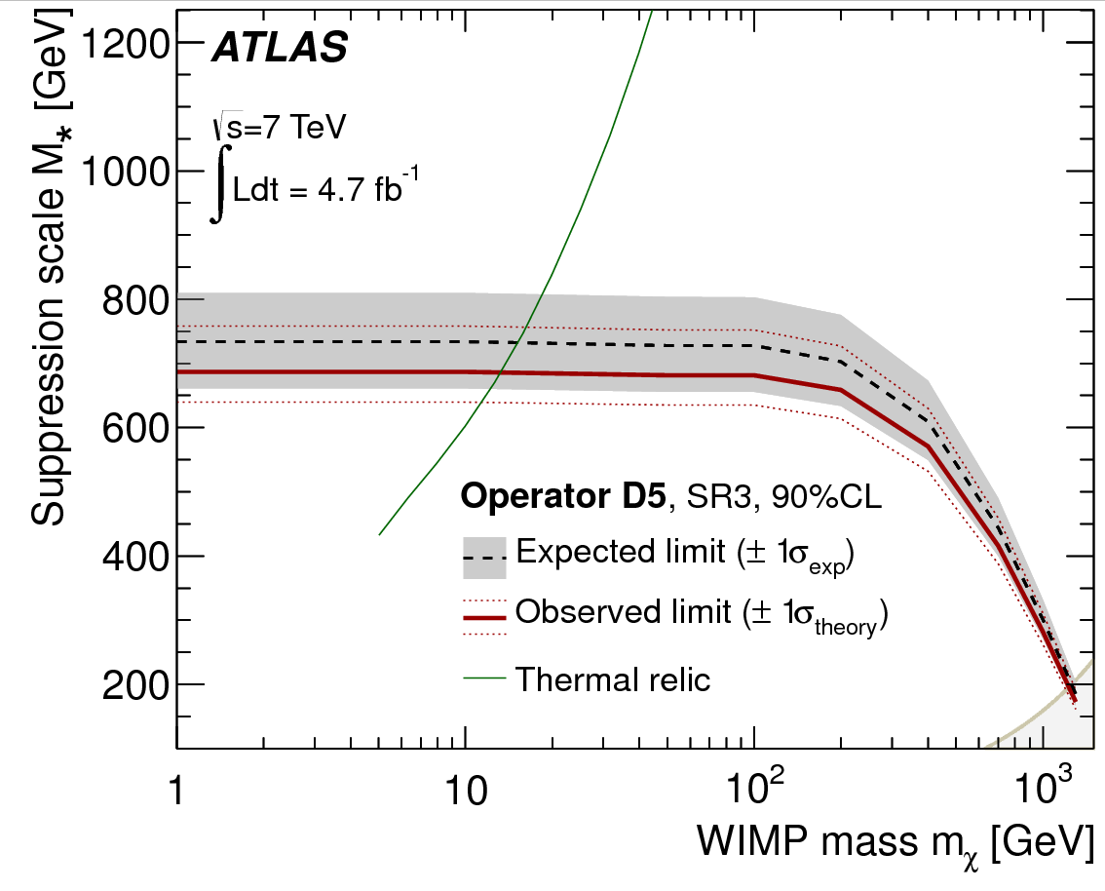
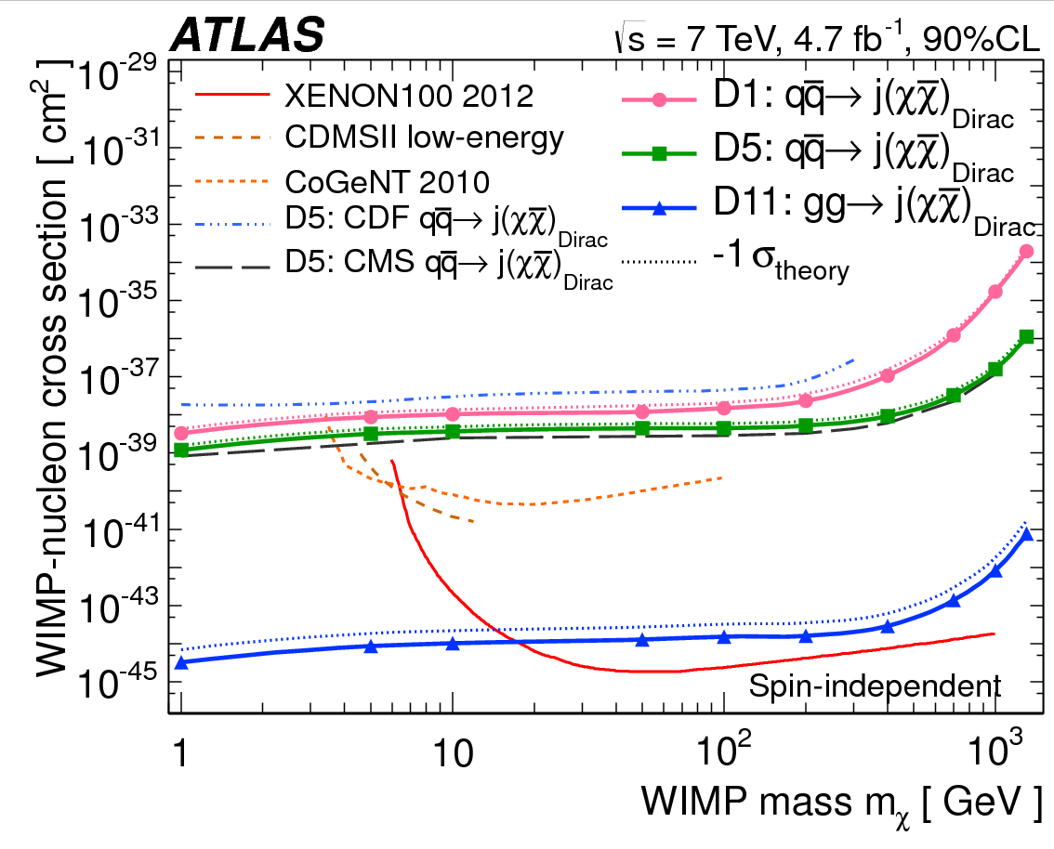
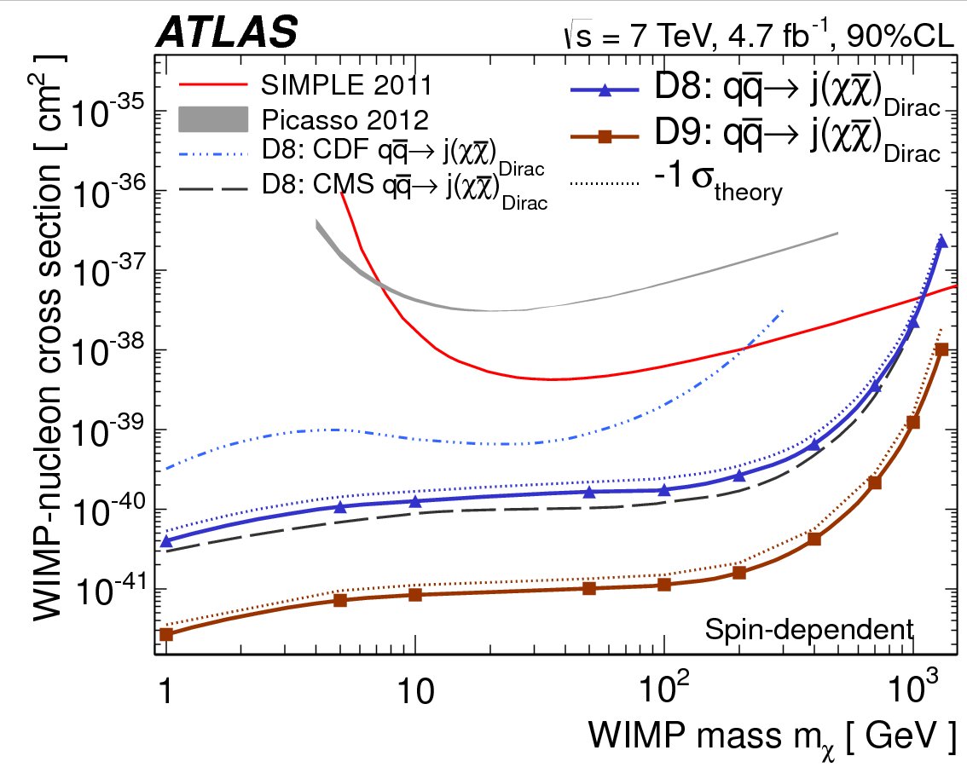
DM interpretation of monojet
Limits above relic density tell that other operators must account for the difference
Bounds on M∗ for a given m_{χ} can be converted to bounds on WIMP-nucleon scattering cross sections
  Compare to direct DM experiments
Best spin
dependent limits
for m_{χ} < 1 TeV
Best spin
independent limits
for m_{χ} < 10 GeV

Slide 24
Virtual graviton
Coefficients in L_{eff} are UV-dependent (unknown parameter Λ)
  Tree-level operator (dim 8) giving spin-2 contribution to scattering
  Predictions are model-dependent
  Since full framework breaks down at a scale ~M_{D}, assume Λ=M_{D}
The techniques employed to detect effects of compositeness can be directly applied to study effects of the local operator T:
Addition of virtual graviton to SM L modifies Drell-Yan
production cross section, especially at high mass:
  Interference term proport to 1/M_{S}⁴ ➔ η_{LL}/Λ² for C.I., η_{LL}=±1
    Assume GRW convention
  Pure contact term proport to 1/M_{S}⁸ ➔ 1/Λ⁴ for C.I
  Unresolved mass spectrum of various KK-modes
➔ look for deviations in high M_{ll} distribution

Slide 25
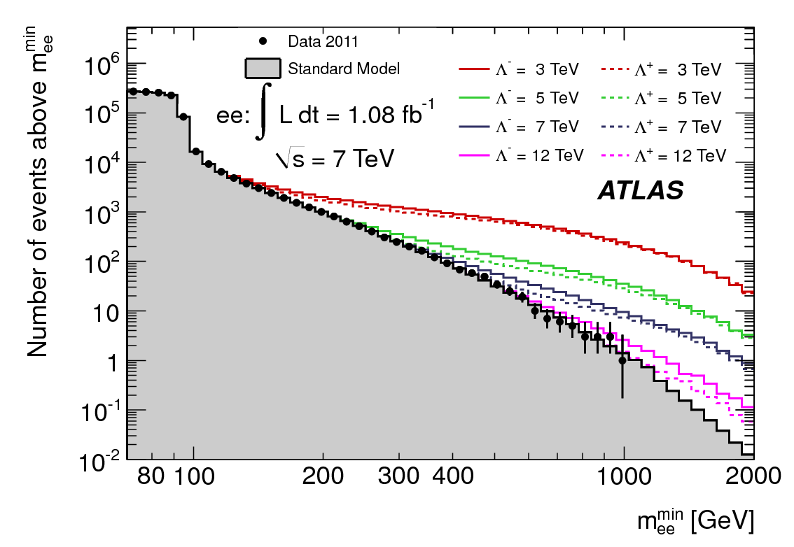
The Search
arXiv: [hep-ex 1112.4462]
Look for excess in Min{M_{μμ}}, not for a peak
  Drell-Yan predicted from MC
  Total background normalized to data under Z peak
Cumulative
distribution
Muon channel
also considered

Slide 26
Limits on Contact Inter.
Use bayesian approach with 1/Λ² prior
95% C.L. limits on Λ with constructive and destructive interference
Limits slightly weaker if Λ⁴ prior is rather used

Slide 27
Diphoton
ATLAS-CONF-2012-087
RS diphoton channel also used to constrain virtual graviton
Signal region considered: Mγγ>1217 GeV
  Optimized for M_{S}=2500 GeV, n=2, in GRW convention
  95% C.L. limits on 1/M_{S}⁴

Slide 28
Black Holes

Slide 29

Models Assumptions (I)
Set in the ADD scenario
Semi-classical approximation
  Valid for √s >> M_{D}
  ➔ assume a min threshold (M_{TH})
Two classical solutions depending on relative angular momentum between incoming parton (spin ignored) :
  Schwarzschild solution (non-rotating BH)
  Kerr solution (rotating BH)
BH evaporate (Hawking radiation):
➔ determine multiplicity and energy spectrum
  Larger for lighter and highly rotating BH
  Grey body factor modify emission spectrum
    Depend on spin, n and BH properties

Slide 30
Model assumption (II)
Close to M_{D}, quantum effects become important and BH decay to smaller number of SM particles
➔ Thermal radiation up to M_{D}, then remnant
  Depend on remnant model
  Burst model of Blackmax
Alternative: LED embedded into weakly-coupled string theory
  Hawking evaporation phase ends when mass reaches a critical value M_{S}/g_{S}² (string scale and coupling)
  ➔ high-entropy string states – string balls (SB)
Conservatively assume M_{TH} > 5 M_{D} for BH and 3 M_{S} for SB

Slide 31
Signature
Exact spectrum is rather model dependent
  inclusion of black hole rotation leads to a somewhat lower multiplicity of higher energy emissions
A robust prediction of these models is the expectation that particles are produced approximately according to their degrees of freedom
  Universal coupling of gravity
  Probability of leptonic emission depends on multiplicity so on BH and evaporation properties
15-50% of events with at least on high Pt lepton
  Uncertainties on gravitational radiation and on decay when M M_{D} (assume to immediately go to a remnant state, in which the multiplicity is uncertain)

Slide 32
The search (I)
Phys. Lett. B716
Mass continuum above M_{D} to √s
Expect excess of high mass object above M_{TH}
  Remove from distributions unreliable predictions
➔ Search for excess of multi-object events containing at least a
charged lepton in high ΣP_{T} region
  High BH efficiency, suppressed QCD bkg
  At least three objects
    no sensitivity to two-body quantum BH states
    Each with P_{T}>100 GeV, ΣP_{T}>1500 GeV
    Mitigate the effect of large remnant uncertainty
Use MC normalized to data in some CR to estimate BKG

Slide 33
The search (II)
Data agree
With SM
Expectation
➔ limits

Slide 34
Model specifics
Two generators: Charybdis and Blackmax (+ pythia)
  No radiation losses in the formation phase are modeled
  High multiplicity distributions from both
    Concordant
  Low multiplicity distributions from Charybdis
  Both rotating and non-rotating BH from both generators
  n=6 extra dim
    Smaller M_{D}
  Charybdis used for string balls with same conditions as for BH
    g_{s}=0.4
  M_{TH} in [3,5] TeV

Slide 35
Limits on BH
Signal efficiency varies: 55 to 65% (elec), 40 to 50% (muon)
Signal acceptance (probability of high-P_{T} lepton) is rather Model-dependent
  Eg: 10%
95% C.L. observed (expected) upper limit on fiducial cross section: 16.7 (20.4) fb
Exclusion limits are set for the exact benchmark models as implemented in the Blackmax and Charybdis generators

Slide 36
M_{TH} vs M_{D} limits
Black hole high multiplicity remnant state (Blackmax)
Black hole low multiplicity remnant state (Charybdis)
Irregularities in limit contours are caused by
discreteness of grid samples generated

Slide 37
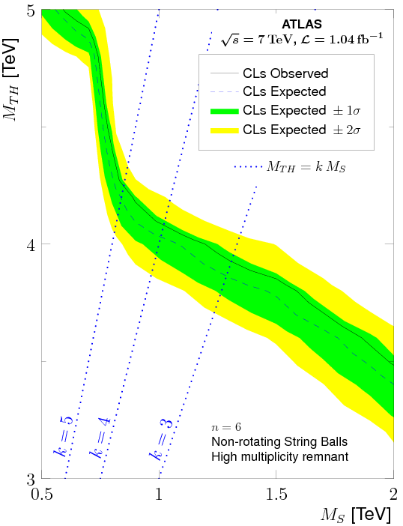
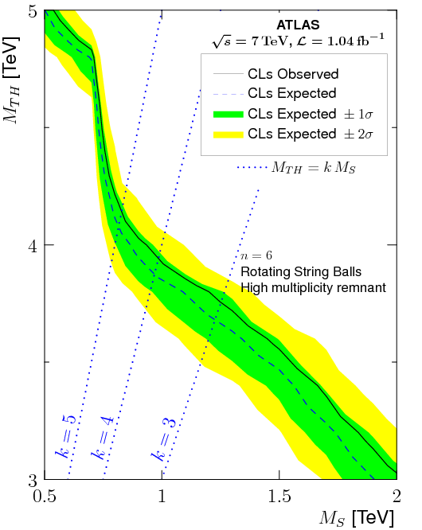
M_{TH} vs M_{S} limits
Rotating and non-rotating string ball with high multiplicity remnant (Charybdis)

Slide 38
Dimuon search
arXiv: [hep-ex 1111.0080]
Focus on track multiplicity and higher lepton multiplicity rather than on objects and jets
Select events with two same sign muons, one must be isolated
➔ High signal efficiency, very low bkg
Signal region: Ntrk>=10
Estimate:
ttbar and others from MC
b/c and m+fake, from Ntrk<10
No excess!

Slide 39
Limits on BH
95% CL limit on σxBRxA = 0.018pb
  BRxA between 1% and 6%
  Truth to reco correction: 0.7 +/- 0.1
No significant improvement expected before 14 TeV
Non-rotating
Rotating
Weaker
limits for
n=2 than
n=6
Weaker
limits than in
Multi-object
analysis

Slide 40
Other resonances

Slide 41
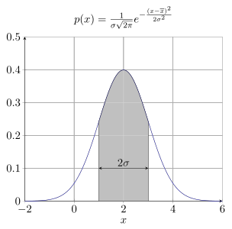
Other resonances
Resonances can be predicted by some gravity-based signal
  E.g.: Regge excitations of string theory predicts gamma-jets and dijet resonance
NO explicit limits on quantum gravity models have been made from such searches for resonances
Model independent searches for resonances have been made and model-independent limits on Gaussian peak have been set.
➔ They can be used for your own
model!

Slide 42
Analysis strategy
Analysis strategy similar than for diphoton RS resonance:
  Quality object selections and clean-up cuts are applied
  Invariant mass reconstructed above a certain threshold
  Fit mass spectrum to smoothen the invariant mass distribution
    ➔ bkg prediction
  Choose binning
    Optimal when bin size = 1σ, i.e. half resonance width
  Run Bump hunter algorithm
  Set limits

Slide 43
Limits
ATLAS-CONF-2012-088
Phys. Rev. Lett. 108, 211802
Limits are set on hypothetical signals assuming a Gaussian resonance of mean m_{G} and of width σ_{G} varying from 5% to 15% of the mean
  Similar as RS limits on diphoton, or limits on contact interaction
Dijet
Gamma+jets
8 TeV
data

Slide 44
For your model
If you want to use general results and apply them to your model, you must:
  Generate MC sample at mass M
  Apply selection cuts
  Smear signal mass according to detector resolution
    For ATLAS: σ_{M}/M = 5% for 1 TeV, 4.5% at 2 TeV, asymptotically reaching 4% at 5 TeV
  Suppress the tail of your “reco” Mass because Gaussian hypothesis
    Keep m between 0.8M and 1.2M
  Compute acceptance
  Check quoted limit on σ x A in published tables for m_{G}=M
    Use quoted value for σ_{G} = (1.2M – 0.8M)/5

Slide 45
Conclusion

Slide 46
Summary
Quantum gravity predicts features that can be embedded in quantum field theory and tested at the LHC if extra dimensions
  Direct graviton productions
  Virtual graviton transfer
  Transplanckian states
ATLAS at the LHC tested quantum gravity by looking at phenomena where general extra dimension scenarios predict deviations with respect to SM
  Many resonances
  Monojets, monophotons
  Multi-object final states
No deviation obtained ➔ constrain low energy QG features
Model-independent limits on other models can also be used

Slide 47
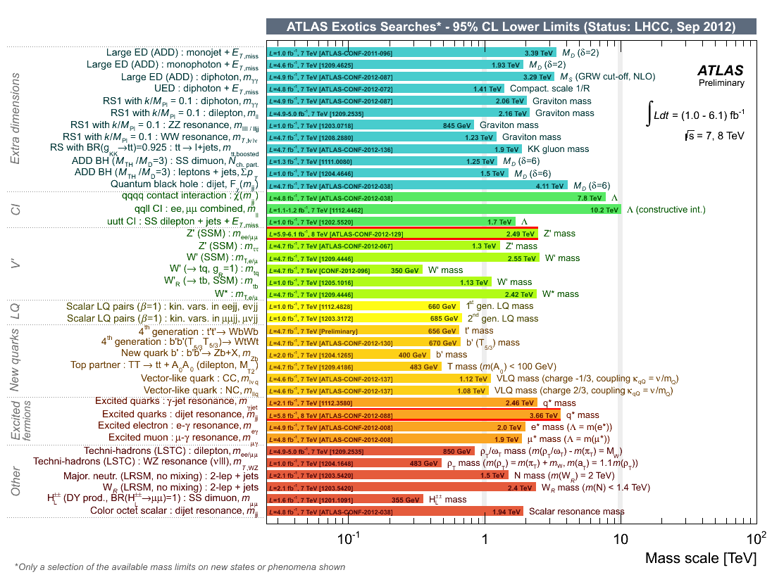
Complete set of ATLAS limits

Slide 48
Thanks to collaborators!!!

Slide 49
Back-up

Slide 50
Graviton couplings
Graviton couples universally to various SM degrees of freedom
➔ Model-independent branching ratio

Slide 51
Dark matter model (I)
Very nice by-product of this analysis is to constrain dark matter production in a model-independent way
  Effective theory with contact interaction
Assumes:
  WIMPs of mass between a few GeV to few TeV range
    Detectable at the LHC
    Cross section account for relic density as measured by WMAP for non-relatistic matter in early universe
  Pair of WIMP produced from parton-parton interaction
    Heavy mediator between SM and dark sector
  Dark Matter field represented as Dirac Fermion
    Some interaction terms disallowed
    Cross section bigger by x4
    Can express t-channels as a sum of s-channels dirac terms

Slide 52
Dark Matter model (II)
Examples of operators considered
  Chosen because they correspond to different E_{T}^{miss} shapes and so generate potentially different limits
2 parameters: M* and M_{χ}
  M* = M/sqrt(g₁g₂)
    g₁, g₂ = couplings of the mediator of mass M between WIMP and SM
  Coupling flavor universal with 4 lighter quark flavors

