Slide 1
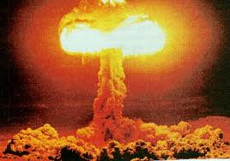

The mystery of the nucleus
Pierre-Hugues Beauchemin
PHY 006 –Talloire, June 2013

Slide 2
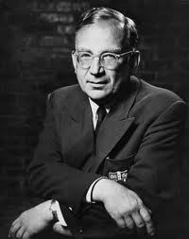
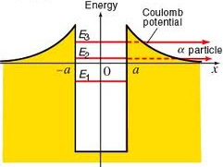
Coming back to α particles
The α particles have an exponential decay rate characterized by the half-life τ: N=N₀e^{-t/τ}
Georges Gamow showed in 1928 that alpha particle emission and absorption must be described by quantum mechanics
  Treat as a particle trapped in a box
  The particle is in a bound state because of the presence of a strong potential.
  Can escape the box by tunnel effect
  Correctly described the Geiger-Nuttall’s empirical law relating the half-life with the kinetic energy of α particles

Slide 3
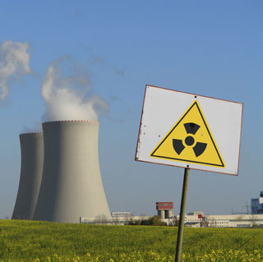
The discovery of the neutron
The idea of a neutral particle composing the nucleus
has first been proposed by Rutherford to explain the
difference between atomic number and atomic mass
  This particle was believe to be an electron-proton bound state
The electron-proton bound state model was proved wrong in 1930 by Hambardzumyan and Ivanenko using the new quantum mechanics (particle in a box) and the uncertainty principle
A year after, Bothe and Becker found an unusually penetrant neutral radiation produced from the
bombarding of light nucleus with α
particles
In 1932, Chadwick discovered that the
new radiation was not a γ ray, but
rather a new particle composing the
nucleus: the neutron
  Energy and cross section inconsistent
  with the γ hypothesis
  From a set of experiment he measured the
  mass to me m_{N}=939.57 MeV≅m_{p}

Slide 4
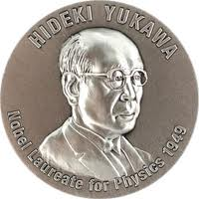
Yukawa potential
The discovery of the neutron confirmed that there are
other particles in the nucleus that interact to keep
together but not with the electromagnetic interaction
Hideki Yukawa proposed in 1934 a theory of why the nucleus are stable:
There is an attractive force between nucleus components which is
stronger than the repulsive electromagnetic force and which
maintain the cohesion of nucleus
Yukawa proposed that the potential energy of this force is given by:
  The potential is negative so the force is attractive
  For r ~ 1 fm, U_{F}(r) >> U_{em}(r), but with increasing r > h/mc, U_{F} goes rapidly to 0
  g >> Q in the r < 1 fm regime
    Remember couplings can vary with energy and therefore with r

Slide 5
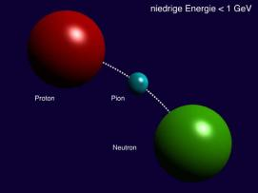
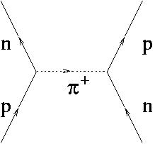
The meson
In quantum field theory, interactions are mediated by particles described by a quantum field
The nuclear force of Yukawa must be mediated by a particle which correspond to the mass parameter “m” in the potential
➔ He named this particle the meson
The reach of the particle is given by its mass.
  Beyond this, its impact on matter is too weak
This particle must have a mass of 100 MeV/c² in order to have a reach of the size of the nucleus
➔ Important prediction on new particles

Slide 6
The wrong particle
Doing similar investigations as those that led to the
discovery of anti-particles, Anderson discovered a
particle with the right 100 MeV/c² mass in 1936
  Cosmis ray particles bending less then electron and more than protons in the magnetic field of the cloud chamber
  He called this particle the mesotron
A decade after, following experimental studies of mesotron’s absorption by various nucleus (Conversi, Pancini and Piccioni) and analyses by Fermi, Teller and Weisskopf, it become clear that the mesotron was interacting too weakly with nucleus to be the meson
  This particle was in fact the muon
“The [muon] particle was originally given the name the "mesotron". As is often the case in science, there was not a "Eureka moment" of discovery, but a gradual dawning of a new paradigm through the work of many people, both theoretical and experimental.” –Mark Lancaster
in The Guardian

Slide 7
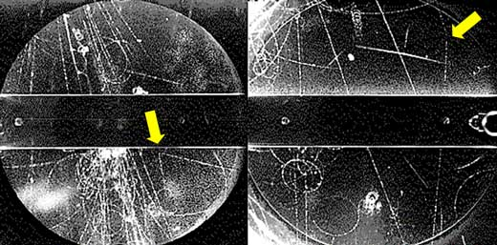
And the meson get discovered!
Hans Bethe and Robert Marshak suggested that the muon might be the decay product of the particle needed in the Yukawa theory, so the search continued
Cecil Powell’s sensitive photographic emulsion techniques allowed to look for cosmic rays reactions in the high atmosphere
In 1947, Powell, Perkins, Latte and Occhialini confirmed the existence of meson (pions)
However, by the end of the year, other mesons get discovered the kaons
The year after, pions got artificially produced by bombarding atoms with energtic a particles

Slide 8
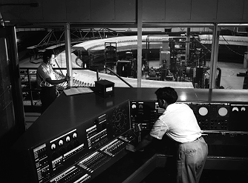
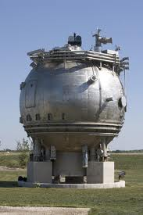
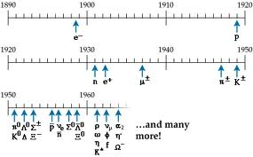
A zoo of particles!
By early 1950’s particle accelerator get used
to produce and study various processes
  Higher rate of high energy events
  Control on initial state and on processes to study
In 1952, Glaser invented bubble chambers, a type of detector using similar ideas as cloud chambers but with superheated liquid rather than saturated vapor.
  The traces get photographed
  Can cope with higher rate of collisions
  Larger numbers of interaction particles-liquid
These progresses stimulated the discovery a truly zoo of particles
In his Nobel prize speech (1955) Lamb said:
“the finder of a new elementary particle used
to be rewarded by a Nobel Prize, but such
a discovery now ought to be punished by a
10,000 dollar fine”

Slide 9
Strangeness and isospin
Two concepts helped created some order in the
particle mess of the 1950s-60s
Strangeness (S):
Was introduced by Gell-Mann and Nishijima to explain the fact that certain particles, such as the kaons, were created easily in particle collisions, yet decayed much more slowly than expected for their large masses and large production cross sections
Collisions seemed to always produce pairs of these particles
➔ a new conserved quantity, “strangeness", is preserved during their
creation, but not conserved in their decay
Isospin (I₃):
Was introduced by Heisenberg in 1932 on the realization that proton and neutron have almost exactly the same mass.
  They could be considered as two states of the same particles in view of a new interaction. Similar isospin get identified for other hadrons
Nuclear collisions seem to conserve isospin

Slide 10
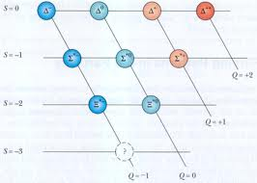
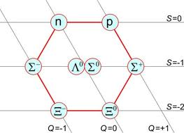
The eightfold way
Similarly as did Mendeleev, Gell-Mann used strangeness, electric charge and isospin to classify all newly discovered particles and find patterns
Strongly interacting particles:
Meson: integer spin
Baryon: half-integer spin
Observed 8-fold patterns for meson and baryons, and predicted the 10-fold pattern for Baryon, where the s = -3 state wasn’t discovered
The underlying symmetry is due to a symmetry between 3 underlying components
➔ Predicted quarks (u, d, s) in 1964

Slide 11
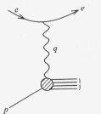
The discovery of the Ω⁻ and quarks…
Predicted by the eightfold way of Gell-Mann, in 1962, the Ω- particle was discovered in 1964
  The Ω- is made of three s-quarks (sss)
Friedman, Kendall, and Taylor studied the diffusion of highly energetic electron through protons (similarly as what Rutherford did,) and observed localized density of energy in the proton ➔ quarks discovery (1968)

Slide 12
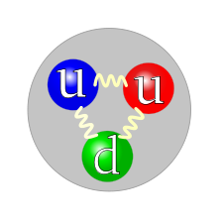
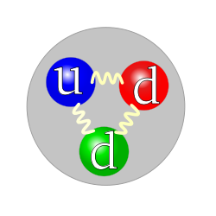
The strong interaction I
In the 70s, physicists succeeded in developing a renormalizable quantum field theory of the strong interaction:
Quantum Chromodynamics
This theory describe the interaction of quarks with the particle responsible for the strong interaction:
the gluons
  Quarks are all the same from the point of view of the strong interaction
The charge responsible for this interaction is called colour
  There are 3 different colour charges quarks can take (r, b, g)
    rather than 2 (+ and -) for the electromagnetic interaction
  Hadrons are colourless objects
This is a proton
This is a neutron

Slide 13
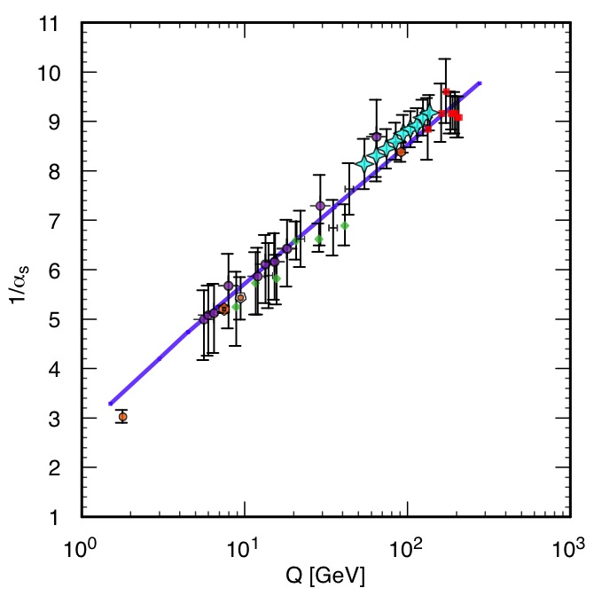
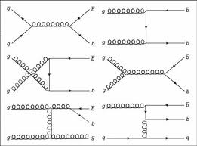
The strong interaction II
This theory is similar than quantum electrodynamics with
the major differences being:
  The strong interaction only acts at short distance scale,
  binding all elements that have a strong charge together
  The force become weaker as the energy increases
    Asymptotic freedom: allows for quark collisions and productions, but they will not be isolated in the detector, they will quickly form hadrons
  Gluons carry colour and can thus interact with each others

Slide 14
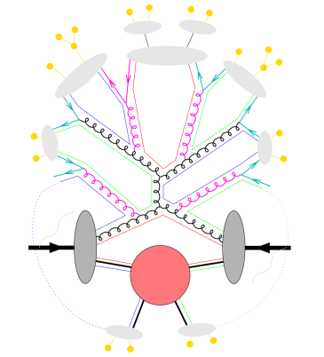
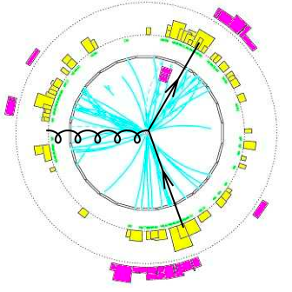
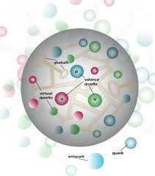
Jets of hadrons
When we collide protons at very high energies, the
particles that “really” collides are quarks and gluons
  many physics processes of interest involve the strong interaction in their description
Can only observe composite states of quark and gluons
  Meson and baryons (= hadrons)
Quarks and gluons in the final state of a given process will appear as a jets of hadrons

Slide 15
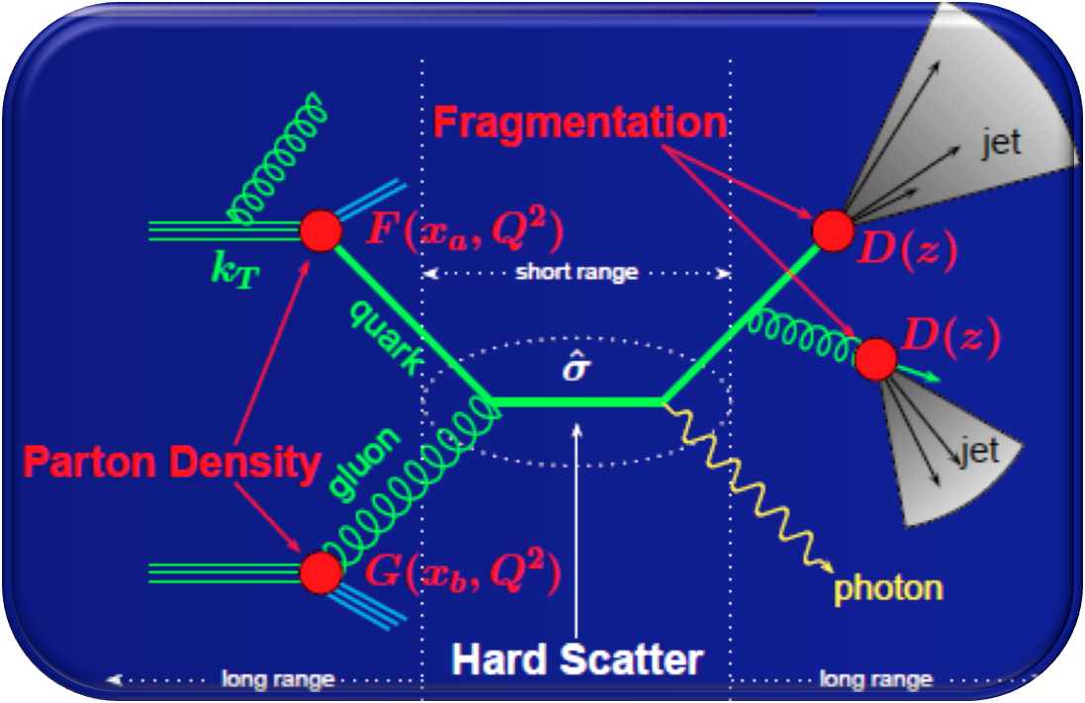
QCD at the LHC (I)
The strong interaction intervene in various ways and at various scales in an event at the LHC
  Hard scatter
  QCD bremsstrahlung
  Parton density function
  Fragmentation and hadronization
  Multiple interaction
Factorization theorem:
Predictions can be obtained from the convolution of short
distance physics and non-perturbative large distance effects:
Allows for robust predictions for a large spectrum of observables

Slide 16
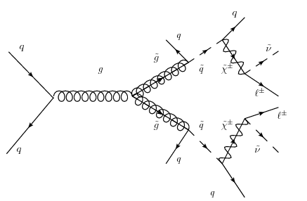
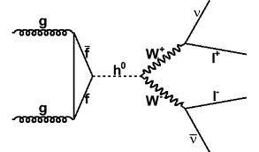
QCD at the LHC (II)
All these aspects of the strong interaction need to be
further studied at the LHC
  Some non-calculable features must be described by
  phenomenological models
  Many assumptions are used to allow for more precise predictions
  Many approximations are used in calculations
  Crucial to study to gain precision
Many new physics process involve the strong interaction
Precision on the strong interaction is a key to discovery

