Slide 1
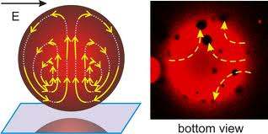
PHY 042: Electricity and Magnetism
Electric field in Matter
Prof. Hugo Beauchemin

Slide 2
Introduction
We continue our description of electrostatic phenomena in realistic setups (experiments, devices, etc.)
Already saw how conductors affect and are affected by external E-fields
➔ Now study insulators (dielectrics)
In dielectrics, electrons stay bounded to an atom
The response of dielectrics to an external E-field is very different than the response of conductors to the same external E-field
Introduce 3 concepts to describe electrostatics in dielectrics:
Polarization: effects of E-field on the material
Bound charges: source of the E-field created by polarized insulators
Displacement field: sum of the above two effects

Slide 3
Approach: pros and cons
Adopt a semi-classical approach: describe the motion of electrons and protons in insulators to external classical E-fields
Only averages over many atoms to offset quantum fluctuations
Attribute the average value to each point in the averaged volume
Pros:
Allow to build a good model/understanding of macroscopic behavior of electrostatics field in dielectrics
Many macroscopic electrostatic systems will be described in the exact same way as the electrons in E-field of our semi-classical approach.
Cons:
Effective theory: approximation only valid at large scale
Depend on a set of free parameters to be fixed by experiments and not by first principles

Slide 4
Polarization
Localization of charges around atoms DOESN’T MEAN external field have NO effect on material
Many natural molecules can be considered as dipoles
Dipoles can be induced in many other atoms or molecules
Electric field acting on these dipoles can produce cumulative effects of charge rearrangements around each atoms leading to a macroscopic phenomenon at equilibrium
POLARIZATION
Two principal mechanisms by which a dielectric material can be polarized
Stretching
Rotating
Polarization can differ at each point in a dielectric: it is a vector field

Slide 5
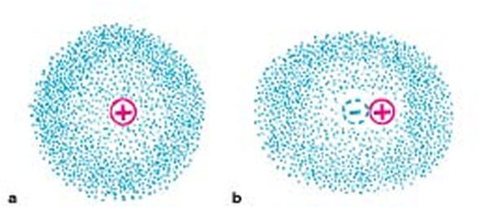
Stretching (I)
Atoms: positively charged nucleus surrounded by negatively charged cloud
Analogous to spherical conductors with + at the middle
Electrons cloud ⬄ free charge carrier
Probability density |ψ|² ⬄ charge distribution
At equilibrium, the external E-field induces a dipole in the atom proportional to the E-field producing it.
Analogy in conductors

Slide 6
Stretching (II)
Polarization, reaction of the material to an external E-field, depends on the structure of the atoms forming the material
Previous picture is a simplistic model
Works nevertheless well if a few properties are used to determine the number of charge carrier to be considered
Higher atomic number ➔ higher polarizability
Lower electronegativity ➔ higher polarizability
Polarizability is axis-dependent is a matrix equation
This is not specific
to atoms and
molecules. It also
describes effects of
polarization
on macroscopic
systems in general
induces
induces
induces

Slide 7
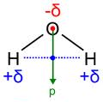
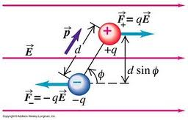
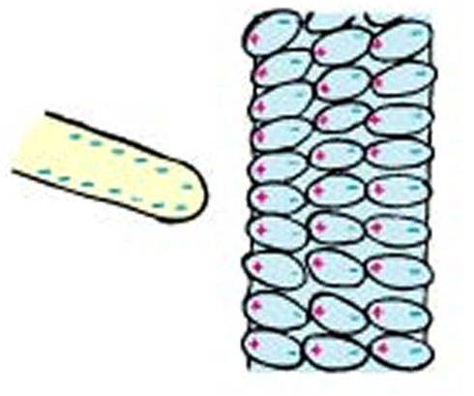
Rotating
Some molecules have permanent “built-in” dipole moments, which normally offset each others
If a uniform external field is applied:
No induced polarization (F_{net}=0)
A torque will be applied on small
permanent dipole elements
Dipoles will align and generate
macroscopic polarization
➔ Insulator can
be taken as
a collection
of pure dipoles
Polarization =
Dipole moment per unit volume

Slide 8
Bound charges
Remember from multipole expansion:
Dipoles generate an electric potential
➔ A dielectric with net polarization generates an E-potential
with and
Are they mathematical fictions or real charges?
A: Non-cancelling dipoles generate local charge accumulation
corresponding to a charge distribution which produce a field
No polarization means no bound charges
Polarization is responsible for external electric field

Slide 9
Electric displacement (I)
E-field generates polarization on an insulator, which produce an E-field modifying the external E-field, affecting the polarization…
We want to describe the situation at equilibrium
Two types of charges
First Maxwell equation in terms of E and total charge can be expressed in terms of displacement field D and free charge
Solely in terms of controllable quantities …
Free charges
Bound charges
Monopole
Distribution controllable
empirically
Dipole
No control on charge
distribution
Def:
Constitutive equation

Slide 10
Electric displacement (II)
The electric field outside a dielectric doesn’t necessarily know anything about the polarization of the dielectric
E.g. long straight charged line surrounded by a rubber cylinder
The surface bound charge σ_{b} can cancel the volume bound charge ρ_{b} in an uncharged dielectric polarized by an outside E-field
Phew! all we did in previous chapter still hold…
Is D independent of bound charges? Can D replace E inside an insulator?
A: NO and NO!
D won’t imply a Coulomb’s law in terms of free charges
D cannot be derived from a scalar potential
D has units of P or ε₀E, not of E

Slide 11
L.I.H. dielectrics
Need experiments or quantum physics to know
Large class of material for which this relationship is known:
Linear: depends on E_{i}, but not on E_{i}E_{j}, E_{i}E_{j}E_{k}, etc
Isotropic:
Permittivity ε and susceptibility χ describe properties of material
Must be determined empirically
Homogenous: susceptibility is a constant
Bound charge effects included in
D describes the situation at equilibrium and allows to solve easily for E and P in L.I.H. dielectrics
Insulators act like imperfect conductors: the polarization of the material shields the charges

