Slide 1
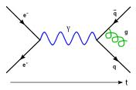
From quantum mechanics to quantum field theory
Pierre-Hugues Beauchemin
PHY 006 –Talloire, June 2013

Slide 2
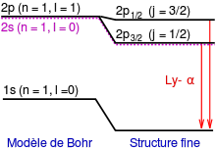
Fine Structure
Spectroscopy, once again, indicates that something is missing in the Schrödinger equation to account for experimental data:
The degenerate spectral line 2S-2P is split when observed with very good resolution spectroscope.
The size of the splitting is ≈0.0005%
Q: What could possibly be missing in the so successful Schrödinger equation?
A: Relativistic corrections!
Relativistic kinematic energy
Spin-orbit coupling
Adding these corrections to the Schrodinger equation yield the right predictions
Degeneracy:
Two states (orbitals)
in which the electron
have the same
energy value

Slide 3
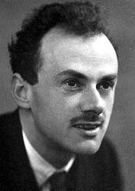
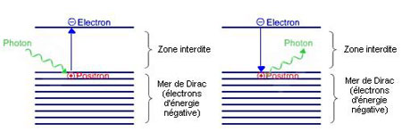
Relativistic quantum mechanics
Rather than adding corrections to the Schrödinger equation, Dirac proposed in 1928 a completely relativistic wave equation named… Dirac equation!
This equation can only make sense (have solutions) if a₀ and a_{j} are 4x4 matrices, and thus if Ψ(x,y,z,t) is a 4-component vector
➔ Dirac equations contains four solutions:
It fundamentally includes spin
It predict positive and negative energy solutions
Dirac solve is negative energy solutions by
Postulating a “sea” filled of negative solutions and
the idea of electron-hole pair production
➔ Dirac thus predicted
the existence of
anti-particles

Slide 4
Cloud chambers: A particle physics detector
Wilson invented cloud chambers in 1911:
While trying to understand cloud formation, he realized that his
experimental setup could be used to make radioactivity visible!
Principle:
Sealed environment with supersaturated vapor of water of alcohol
Charged particles ionize gas which condensate droplets around it
Tracking of charged
particle motion
Build your own:
http://w4.lns.cornell.edu/~adf4/cloud.html

Slide 5
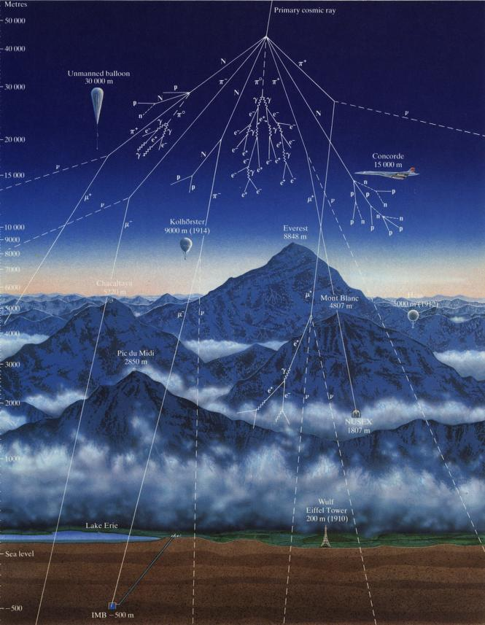
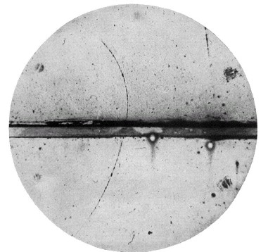
Anti-particles hit the ground!
Cosmic rays constitute the first particle physics accelerators…
Carl Anderson looked (1932) at cosmic rays crossing a cloud chambers embedded in a magnetic field
This is what he observed:
The first particle accelerator… cosmic rays!!!
He discovered antiparticles!!!

Slide 6
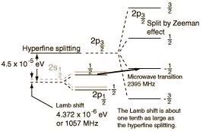
Lamb’s shift
According to Dirac theory, the states 2S_{1/2} and 2P_{1/2} should have the same energy
The index ½ is for the J = L + S
In 1947, Lamb and Retherford, succeeded, using microwave techniques, in stimulating a radio-frequency transition between these two states
The shift was measured to be of 1058 MHz (or 4.37 μeV)
➔ This is a one-part-in-a-million effect
The states 2S_{1/2} and 2P_{1/2} are not degenerated, so the theory must again be extended…

Slide 7
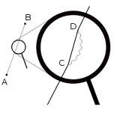
Electron self-energy
The same year, Hans Bethe interpreted this as virtual photons emitted and absorbed by the atom.
The electromagnetic field of the proton is affected by the electromagnetic field of the electron, which feels this modification, hence self-energy effects
Both electromagnetic fields are made of quanta which interact with charge particles
The electron is also a quantum field
This effect changes the mass of the electron
From special relativity, mass is energy
This mass modification depends on the kinetic energy of the electron
These calculations led to infinities, but Bethe realized that these infinities cancel with those occurring in free electron predictions
➔ This is the starting point of renormalization
This effect results in a small displacement of energy levels of an atom by the order of 1000MHz!

Slide 8
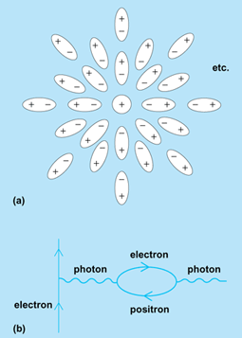
Vacuum isn’t empty
In quantum electrodynamics the electromagnetic field is quantized and, like the harmonic oscillator in quantum mechanics, its lowest state is not zero.
This energy causes virtual electron–positron pairs fluctuations to change the distribution of charges and currents that generated the original electromagnetic field.
Uncertainty principle allows this: ΔEΔt>h
This effect changes the charge of the electron
The charge depends on the energy of the electron
Such corrections also involve infinities that get evacuated by renormalization

Slide 9
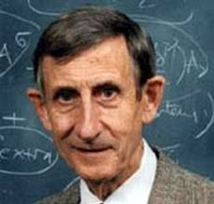
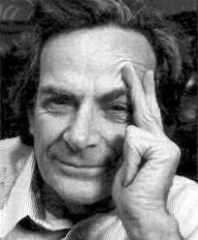
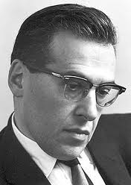
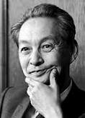
Quantum field theory of electromagnetism
Building on Bethe discovery, Dyson, Feynman, Schwinger and Tomonaga obtained shortly after a complete formulation of the quantum field theory of electromagnetism.
Integrated specially relativity and quantum mechanics
Forces between particles are mediated by other particles
Resolved the wave-particle duality:
particles are excited states of a field of quanta
Formally resolved divergences in the predictions
Proved the theory to be renormalizable regardless
of the level of approximation made
Any order in perturbation theory
Naturally account for infinite degrees of freedom involved in a field
Naturally account for the Pauli exclusion principle

Slide 10
Feynman diagrams
Feynman diagrams represent probability amplitude for a given particle interaction process
E.g.:
Such diagrams are in a one-to-one correspondence with a formal element allowing to compute the probability amplitude.
Amplitude from various Feynman diagrams giving the same final state particles must be summed
The square of the total amplitude give the probability that a reaction occurs and this is used in the cross section calculations

Slide 11
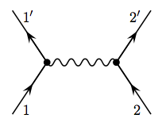
Example I: Muon pair production
μ-
t
e+
e-
μ+

Slide 12
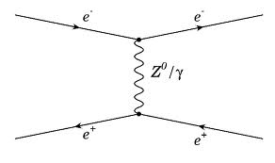
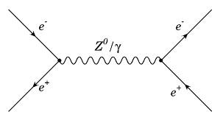
Example 2: Bhabha scattering
Two diagrams are possible:
M = M₁ + M₂ ➔ |M|² = |M₁ + M₂|²

Slide 13
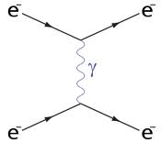
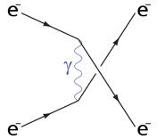
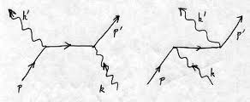
Exercices
Can you draw the Feynman diagram(s) for the following processes?
Möller scattering:
Compton scattering:
γ
e-
γ
e-
e-
γ
e-
γ

Slide 14
A very successful theory!
In the context of quantum electrodynamics (QED), the contributions to the Lamb shift are explained by:
Effect | Energy contribution
Vacuum polarization | -27 MHz
Electron mass renormalization | +1017 MHz
Anomalous magnetic moment | +68 MHZ
Total | +1058 MHz
The QED correction to the magnetic moment of the electron is the most precise theory-experiment comparison in all physics!!!

Slide 15
Do we really understand atoms?
The quantum field theory of the electromagnetic interaction is the most successful theory we have in physics:
It explains observed splitting in atomic spectroscopy
Relativistic effect (fine structure splitting)
Nucleus effects (hyperfine structure splitting)
Vacuum and self-energy effects (Lamb splitting)
Resolves many quantum paradoxes
Provide the most accurate theory-experiment comparison in all physics
But… it is still not enough to understand the original problem of the stability of the planetary atom model:
Why the nucleus of multi-electron atoms don’t very rapidly decay under the strong electromagnetic repulsion of the protons composing the nucleus???
➔ This will bring us further into our quest for particle physics!

