Slide 1
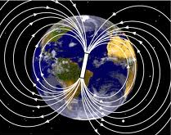
PHY 042: Electricity and Magnetism
Magnetic field in Matter
Prof. Hugo Beauchemin

Slide 2
Multipole expansions I
Recall: one of the advantages of the electric potential V was its multipole expansion:
Dominant structure of extended charge distributions expressed as a superposition of pure (non-extended) multipole moments
Understand gross structures of a charge distribution
Exploit partial symmetries of extended objects
Dipoles were used to model electric field in dielectric material
➔ Can do the same thing with vector potential of current loops
Use full circuit because the observer is far enough to see it all
Avoid infinite current distributions that rend the approximation invalid
Need to expand:

Slide 3
Multipole expansions II
The vector and the scalar potentials share the same 1/r dependence
➔ Vector potential expansion in terms of Legendre polynomial
Assume line current
Same conditions of applicability as for the V multipole expansion:
Valid only at distance r bigger than the size of the circuit
Cannot anymore describe part of the circuit, as allowed by Amperes’s law, because the observer is assumed to see all of it.
Doesn’t work for the infinite idealization of long wire
No monopole term
Remember the physics interpretation of
➔ Magnetic dipole moment term dominates vector potential

Slide 4
Magnetic dipole moment
We can define the magnetic dipole moment in terms of Amperian’s current:
If the source is a volume current density J:
Makes explicit why it is named magnetic “moment”
Interpreted as the intensity of the source of a magnetic field
Always independent of the choice of the coordinate origin
V_{dip} is also independent of the origin when monopole is null
Vector potential dipole term:

Slide 5
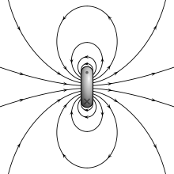
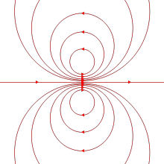
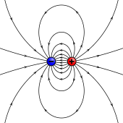
Pure vs physics dipole
Magnetic field of a pure dipole magnetic dipole moment:
Surprisingly, this is identical in structure to the field of a pure electric dipole moment
Same field when assuming pure dipoles, but come from two very different field configurations when assuming physics dipoles
B_{dip} field of a physics
magnetic
dipole moment
Limit E_{dip} and B_{dip}
when m and
p become pure dipoles
E_{dip} field of a physics
electric
dipole moment

Slide 6
Magnetic field in matter
Adopt the strategy used when studying electric field in matter
Take smallest elements of matter considered as current elements
Motion of charges in atoms
Adopt a semi-classical description of such current elements
Consider large distances and times compared to atomic scales
Average over quantum fluctuations
Assign average value uniformly to the full time and distance intervals defining the elements considered and take a classical limit
Describe the effect of an external B-field on each internal material current element using classical laws of magnetostatics
➔ Magnetization
Describe the field created by a magnetized material
➔ Bound current loops
Put both effects together
➔ the H-field

Slide 7
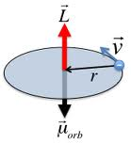
Current elements in matter
This is what makes the connection between magnetic fields created by steady currents and magnet bars
We used this, in the Oersted experiment, to realize that we are not describing electric field of charges in motion, but another phenomenon
From general non-planar magnetic moment definition we can ideally define a magnetic dipole moment for moving charges
Average effects ignoring quantum complications
Electrons in atoms provide pure magnetic moments
Motion around the nucleus
Small average effects of more complicated dynamic
Diamagnetic materials
Spin
No real classical counterpart
Paramagnetic materials

Slide 8
Magnetization
Magnet are simply materials which have a general alignment of the internal “pure” magnetic dipole moments
High temperature randomizes these alignments canceling the net magnetization of the material
An external magnetic field can align the “pure” dipole of matter
Exert NO force to displace atoms and electrons and create currents
Stretches in the circuit must be balanced by mechanical forces or others
Exert a torque on the pure magnetic moment to align them with the external B-field:
➔ Magnetization of the material
Magnetization M: total magnetic dipole moment per unit volume
Complete analogy with the polarization P
2 mechanisms: paramagnetism (spin) and diamagnetism (orbit)
Completely classical description of the
effect of a B-field on a current loop

Slide 9
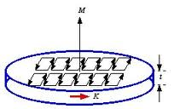
Bound currents
Magnet bars generate magnetic field without steady free current
Magnetized materials are assemblies of aligned magnetic dipoles
Does a magnetized material has macroscopic current density in it???
Calculate the potential generated by the sum of aligned internal dipole moments and see if we can define bound current densities:
Sum of small current elements in material
yields a macroscopic current in the material
A charge doesn’t move throughout the
full circuit, but current genuinely does
That’s also true for steady current
➔

Slide 10
H field
The external B-field modifies local electronic configurations of a material (magnetization) to generate macroscopic current densities, which give rise to a magnetic field modifying the external B-field…
Try to see what is the field configuration at equilibrium
Try to describe the system in terms of controllable quantities
Define the H-field to get Ampere’s law solely in terms of free steady currents (controllable)
Ampere’s law is in terms of the total current density (free + bound)
or
Replacing B by H won’t eliminate the magnetization sources:

Slide 11
D vs H
H is much more frequently used (and useful) than D, why?
Both concepts share similar connections to the E/B fields
The asymmetry in usage is purely pragmatic, based on experimental reasons:
In a lab, we can only control (manipulate, measure) macroscopic quantities, which are then related to other quantities
In E&M, we can manipulate and measure currents and potentials
Charges are more difficult to manipulate (use currents)
H is determined by free currents ➔ directly controllable
E is determined by V ➔ directly controllable
Using a battery for example
Experimental conditions and empirical procedures encourage
the descriptions of E&M phenomena in terms of E and H.

Slide 12
Linear Isotropic homogenous media
As for polarization, magnetization is proportional to an external field when the material is linear, isotropic and homogenous (L.I.H.)
Recall: P = ε₀ χ_{e} E for the polarization in a L.I.H
Similarly as for polarization, we would like to express the relationship using controllable quantities
Use P=P(E) because we control V
Use M=M(H) because we control I
M has same units as H, so the coefficient of proportionality is dimensionless:
Magnetic Susceptibility χ_{m}
χ_{m} > 0 ➔ paramagnetic
χ_{m} < 0 ➔ diamagnetic
types of magnetization
can be classified by
measurements
Permeability of material

