Slide 1


Relativity
Pierre-Hugues Beauchemin
PHY 006 –Talloire, May 2013

Slide 2
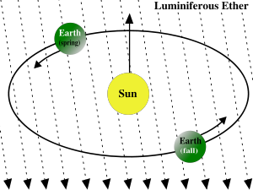
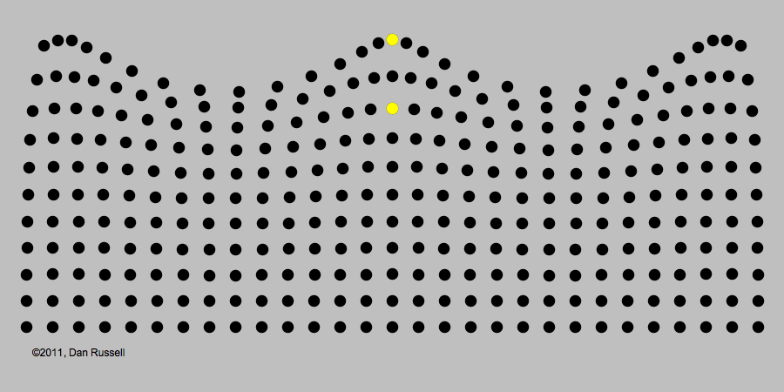
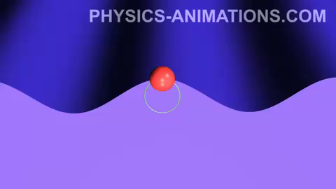
The ether
By 1865, it was theoretically established by Maxwell that light is the propagation of an electromagnetic wave
  The Hertz experiment of 1887 supported this
All known forms of wave were always supported by some medium
  E.g. no sounds wave in vacuum
What is the substance through which light
is propagating?
  Statics immutable ether was postulated
Motion of earth and sun expected to create
wind ether effetcs, detectable as
deviations in the measured speed of light
  V_{earth} ~ 30 km/s => require 0.01% precision!

Slide 3
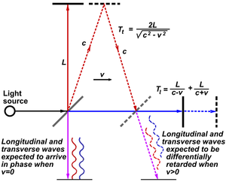

Michelson-Morley experiment
American physicists Albert Michelson and Edward Morley performed in 1887 a very precise experiment to determine the speed of ether wind.
  Galileo’s speed addition predict a phase difference between light parallel to earth motion and light perpendicular to this motion, yielding an interference pattern
  The device was rotated to produce a displacement of the interference pattern
Result indicated a velocity of the earth consistent with 0, within experimental errors
  Experiment was repeated with increasing precision leading always to a null result.
No evidence for stationary ether!

Slide 4
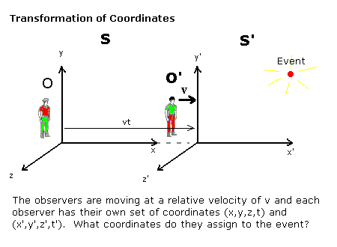
Galilean transformations
Physics laws should be invariant regardless of if an observer carry an experiment in a train or on a platform
  Physics laws were believe to be invariant under Galilean transformations
    Determine how to convert observations from one referential (e.g. the train) to another (e.g. the platform)
These
transformations
should leave
the laws of
physics
invariant
… but they
don’t!!!

Slide 5
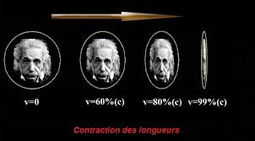
There is something rotten in the kingdom of Denmark…
While Galilean transformation were applicable to all known physics law for long, they proved to not leave Maxwell equations invariant
  1888: Heaviside shows that electromagnetic forces is affected by the state of motion of charged particles
  1889: Fitzgerald uses Heaviside equations to show that ether hypothesis can survive Michelson-Morley experiment because the device get contracted along the direction of motion due to changes in interatomic force changing the structure of objects
    This is an ad hoc hypothesis
  1892-1904: Larmor and Lorentz determined that the set of transformations which leaves Maxwell equations invariant and showed that Fitzgerald contraction is a by-product of such transformations
    Introduced an auxiliary time transformation to relate observation in a fictitious reference frame of the field to true observers in the ether
  1900-1905: Poincare interprets the local time of Lorentz as an effect of clock synchronization using light signal of finite speed, and developed the group structure of the symmetry

Slide 6
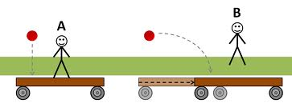
Einstein’s relativity
It is Einstein (1905) that finally solved the problem:
He demonstrated that this is a genuine effect of space-time and not some fictitious calculation to account for Michelson-Morley null results
He showed that the complete set of Lorentz transformation follow from two very general and fundamental principles:
  The principle of relativity:
    The laws of physics are the same for any observers in uniform translational motion with respect to each others
  The principle of invariant light speed:
  The speed of light in empty space is independent of the
  state of motion of the emitting body
    Einstein also assumed the isotropy and homogeneity of space, and the time amnesia of measurement space and time measurement processes
Einstein reconciled electromagnetism with mechanics and eliminated uselessness the concepts of ether and absolute referential frame.

Slide 7
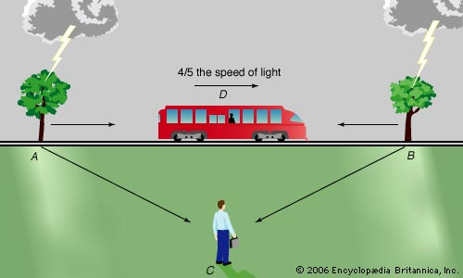
Relativity of simultaneity
Because the speed of light is finite, two observers in relative motion with respect to each others will not agree on the simultaneity of two distant events if their relative speed is not much smaller than the speed of light
  Simultaneity is completely dependent on the referential in which two spatially separated events are observed
Such two in different inertial frame cannot synchronize clocks and rulers and thus cannot agree on time, distance and velocity state of a system
No one is right or wrong, simultaneity is genuinely relative
The observer C sees lighting hitting
both trees simultaneously, while
the observer D sees tree B hit first

Slide 8
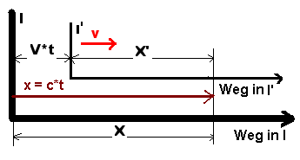
Lorentz transformations
All the physics law of any interactions of nature must
be invariant under Lorentz transformations
  Replace Galilean transformation and applied to E&M
  Relate the measurements of space-time coordinates made by two observers in different inertial frame
Need referential frame to measure phenomena with clocks and rulers
  I.e. convert measurements made with rulers and clocks from different inertial frame in a correlated way
  The world is 4D
If c=∞, we get Galilean
transformations

Slide 9
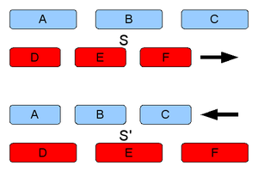
Space contraction and time dilatation
If observers in two different inertial frames measure
different values for the position and the time at which
an event occurs, they will thus not measure the same positions for
the two ends of a ruler, nor the same times for two ticks of a clock
Distances and durations are also relative!
Time get dilated:
Length get contracted:
No observer can realize this by themselves; they can only when they compare with other observers in motion relative to them
Observers from both frames think the other clock is slower…
  An analogy: if two people are far from each others, they both see the other smaller than they are when they are close to each others

Slide 10
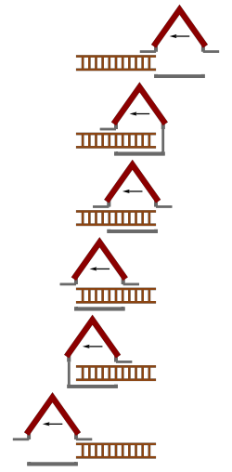
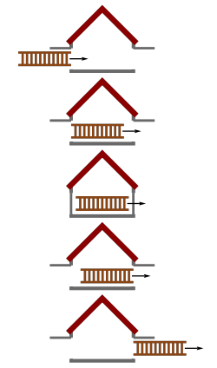
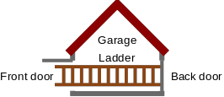
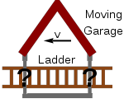
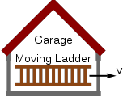
Ladder paradoxe
Problem: how can you fit a ladder in a garage when the ladder is longer than the garage?
Problem: From the perspective of an observer at rest with respect to the ladder it is the garage which is moving, not the ladder, and thus it is the garage that get contracted.
The ladder will then fit even less in the garage.
Is this a paradox?
Solution: make it travel close to the speed of light such that it gets contracted enough to fit entirely in the garage
Solution: The doors don’t get simultaneously closed and so there are no accidental crash of latter with the doors in a specific frame and thus no paradox
This is the perspective of an observer
at rest with respect to the garage
This is the perspective of an observer
at rest with respect to the ladder

Slide 11
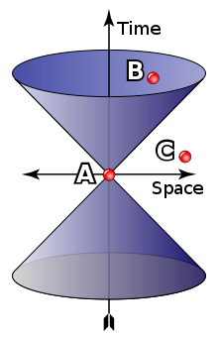
Causality
Nothing can go faster than the speed of light… including neutrinos
  At the speed of light, the lengths get contracted to 0, time dilatation is infinite, Lorentz transformations diverge, etc.
  While no signal or information cannot propagate faster than the speed of light, some phenomena might appear otherwise
    E.g. a laser spot on a far object when the laser is rotated close to the speed of light
Causality is defined by the cone of light propagation in a Minkowski space
  There cannot be any causal connections between A and C in any referential frame
  If there is a causal connection between A and B in a frame where they are at same location, than there will be such causal connection in any frame
  Minkowski diagrams are used to represent four-dimensional space time phenomena

