Slide 1


Monojet events:
A Journey into the Standard
Model and Beyond…
Pierre-Hugues Beauchemin
Tufts University
Perimeter Institute, November 22nd, 2011

Slide 2
A signature-based search
Outline
Introduction
How to look for new phenomena:
  In this section we will discuss the LHC, the ATLAS detector and performance studies, W/Z-Physics measurements
Data-driven estimate of background in monojet events
Search for new physics with monojet events
Conclusion

Slide 3
INTRODUCTION

Slide 4
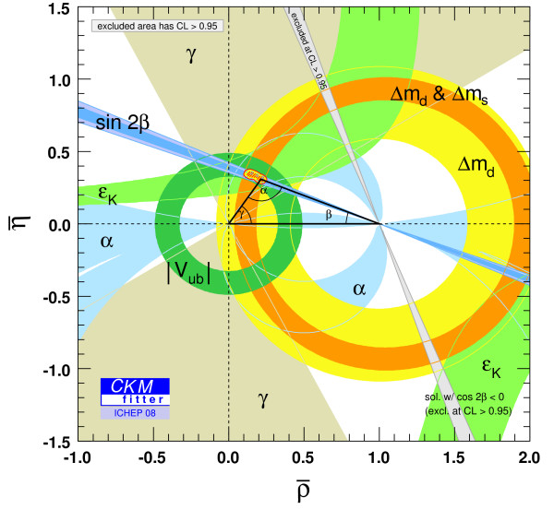
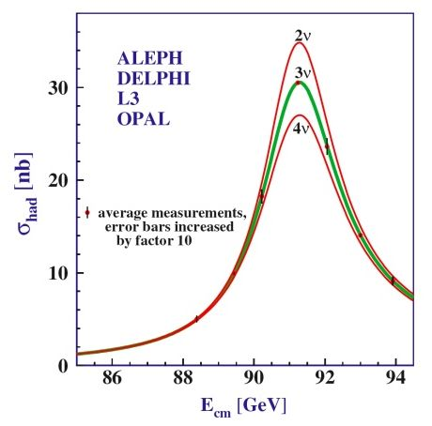
A signature-based search
Standard Model success…
SM provides an accurate description of the HEP data collected … so far!
EWK parameters
Anomalous magnetic moment (g-2)
Top and W mass
The Standard Model has stood against the large spectrum of really precise experiments that tested it:
  Hard constrains on what can be beyond the SM
  SM constitutes a powerful tool to allow to go beyond it…
CKM angles
Z⁰ width
α_{s} running

Slide 5
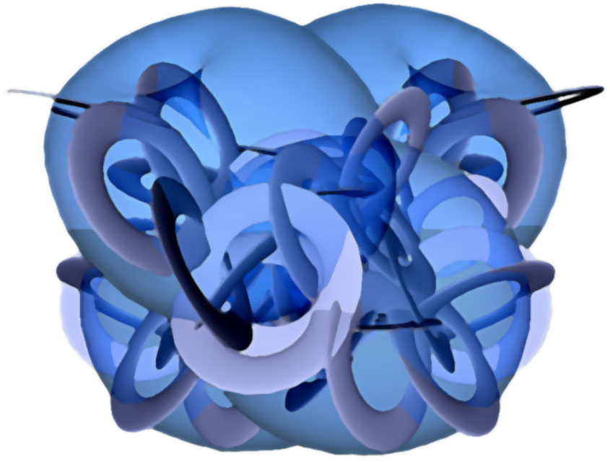
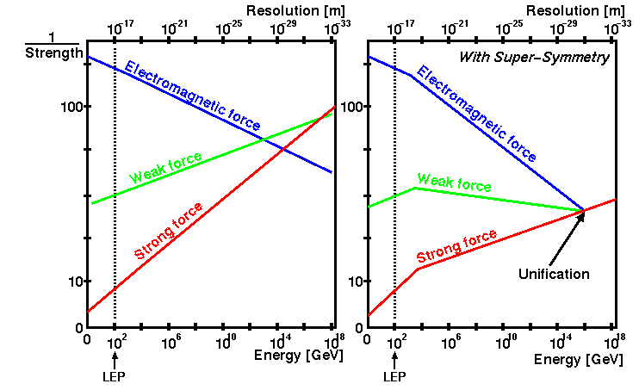
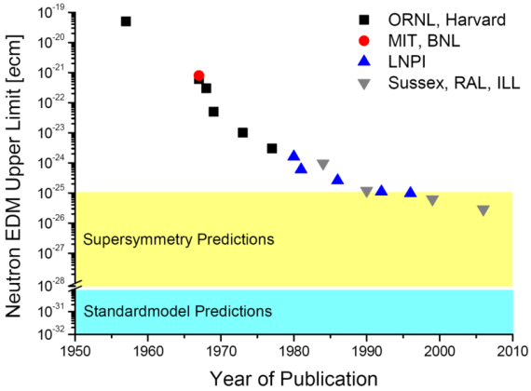
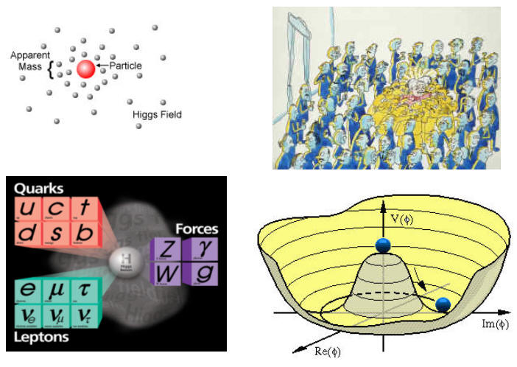
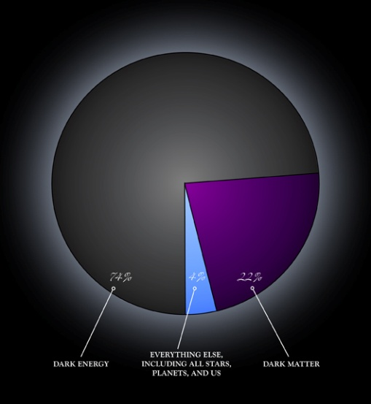

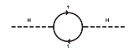
A signature-based search
… and its limitations
… But the SM cannot be the end of the story for it leaves many unanswered questions.
Space-time Structure
& Gravity
Need to find New Physics!
Strong-CP problem
Unification
Fine tuning
Hierarchy Problem
Dark Matter
Dark Energy
ElectroWeak Symmetry Breaking

Slide 6
A signature-based search
In today’s presentation
We will illustrate one powerful approach to search for new physics with one specific example:
Search for Large Extra Dimensions
Along the way we will see:
  How well the ATLAS detector is doing
  How to dig a signal out of a large background
  How current LED limits have been obtained

Slide 7
How to look for new phenomena?
1- Choose a final state:

Slide 8
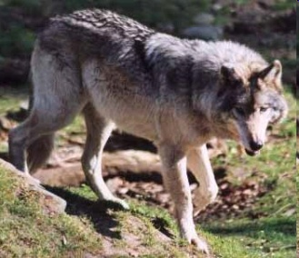



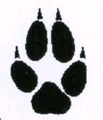
A signature-based search
Signatures-based searches
New physics searches can be experimentally conducted with a minimal set of theory assumptions
  Choose a final states with some motivation
Different models can contribute to the same phenomena
  Toy/simpler models are often used
  Often difficult to disentangle them
  In case of discovery, interpretation will only be speculative
⇒ No good reason to favour a
model over another for a
search in a given final state

Slide 9

A signature-based search
Model-Independence!
Don’t want to miss unexpected new physics because of our selections…
  No optimization for a particular model
If no significant signal is found:
severe constraints can be set on a
benchmark models for comparison:
  Eg: Large Extra Dimensions
  Allow theorist to reuse limits
The price to pay for model-independence is a potential
loss of sensitivity to some benchmark models

Slide 10
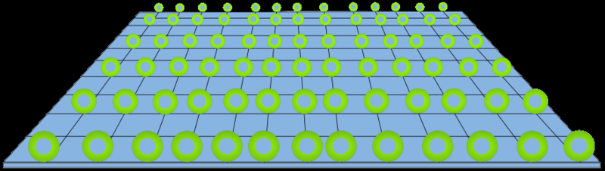
A signature-based search
Extra dimensions
From the model-independence perspective, a good benchmark model would be simple
  Extra dimensions only depends on Planck Scale in D-dim
It would also have many models predicting similar phenomenology
  Generic dark matter models, splitsusy, invisible Higgs are examples of models predicting signal in some typical LED final states
Model would solve problems
  LED needed to explain dark energy
    Experts are in the crowd!
⇒ Good justification for a signature

Slide 11
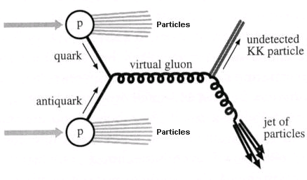
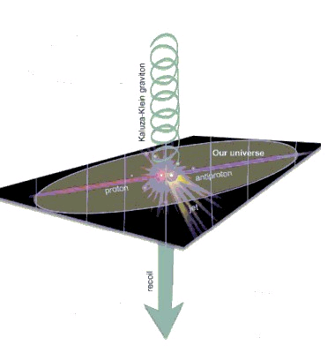
A signature-based search
Graviton in hadron colliders
Gravity interacts with all particles
  Direct production of graviton’s
  Kaluza-Klein (kk) modes
Production rate can be high:
  Experiments happen in 4D
  ⇒ probability of graviton ∝ 1/M_{Pl}²
  Any kk graviton can be produced
  ⇒ Sum over all possible kk-modes:
  density of states = (M_{Pl}²/M_{D}^{n+2}) m^{n-1}Δm
  ⇒ production rate ∝ 1/M_{D}^{n+2} >> 1/M_{Pl}²
The produced gravitons escape detection
Signature : 1 jet + unbalanced momentum (E_{T}^{miss})

Slide 12
How to look for new phenomena?
2- Powerful devices:
The LHC accelerator and the ATLAS detector

Slide 13
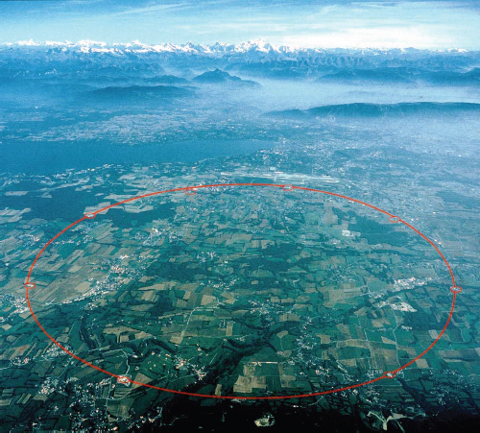
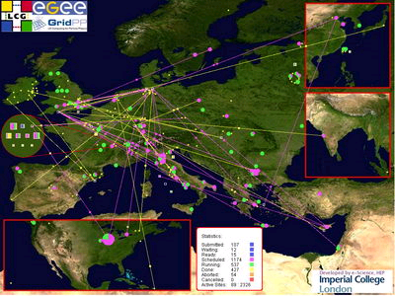
A signature-based search
A new energy frontier: the LHC
The LHC is the world largest and highest energy particle accelerator
  It is 27km long
  Achieved 7 TeV of CoM energy in 2010-11 thanks 1200 dipole magnets
  360 MJ stored in the beams
  (85 kilograms of TNT)
  Magnet at 4T
  Magnet cooled down to 1.8 k ∴ cooler than deep space
  energy stored in magnet:
  5 GJ ⇔ 1.2 tons of TNT
  300 MB of data collected per sec
  ⇒ Computer Grid

Slide 14
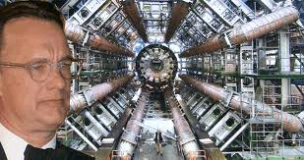
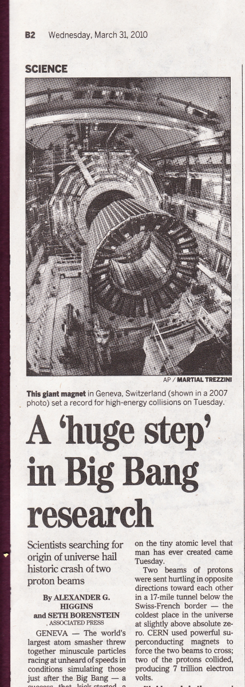

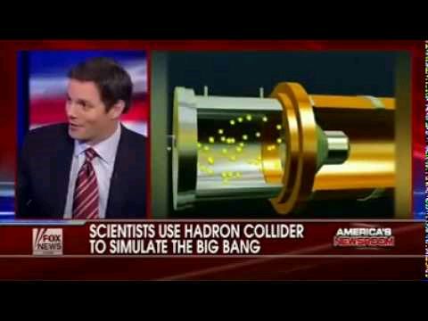
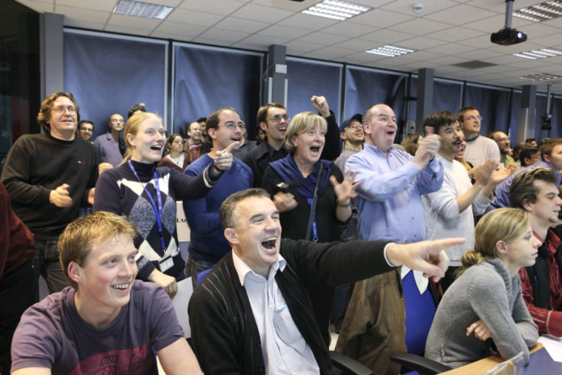
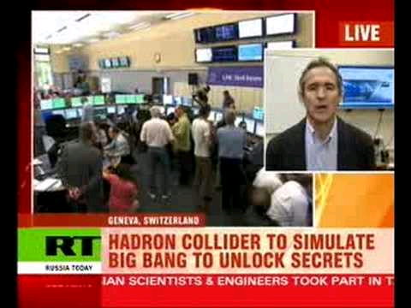
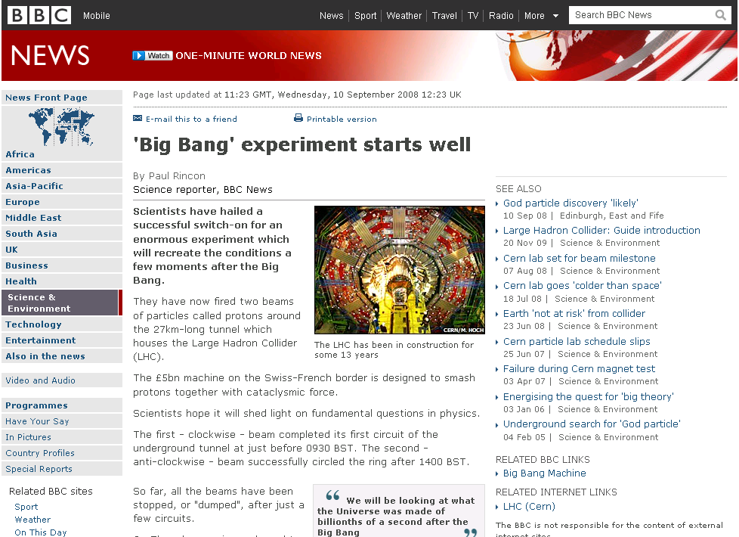

A signature-based search
A lot of excitement around LHC!

Slide 15
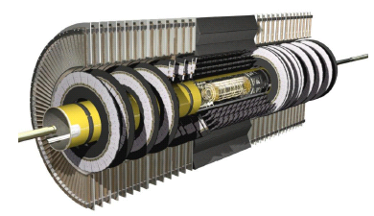
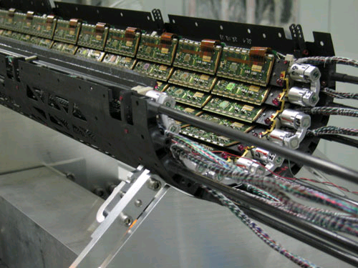
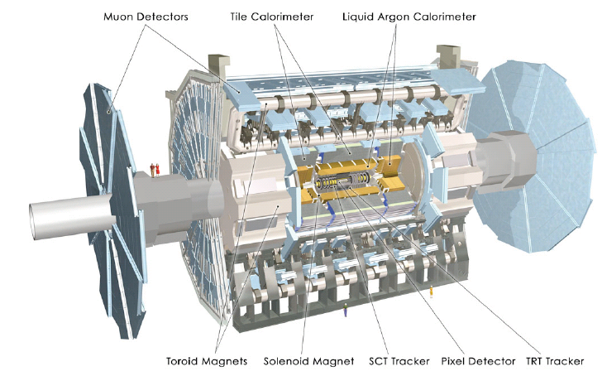
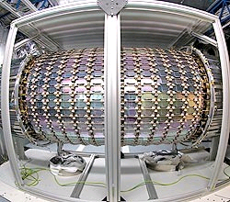
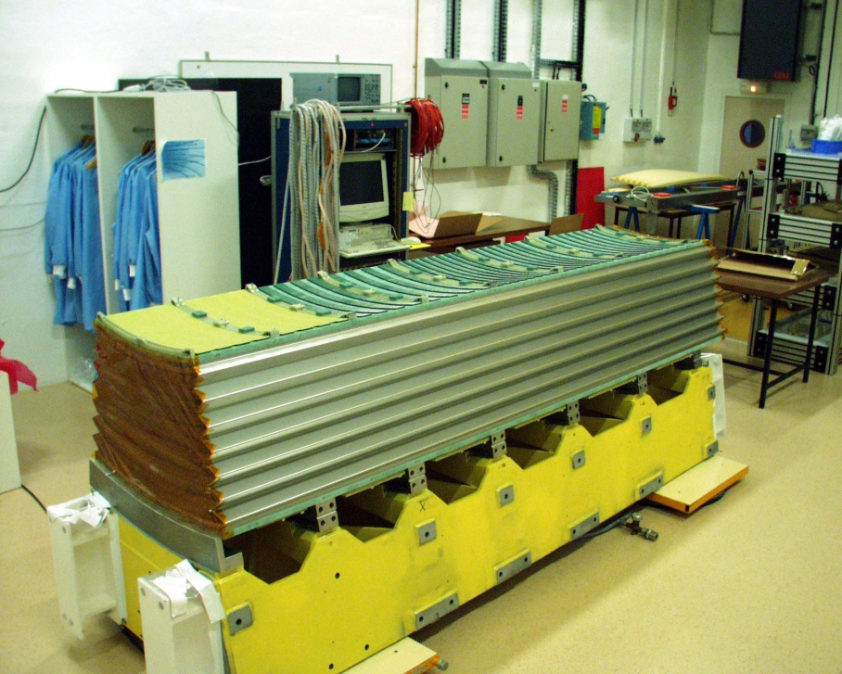
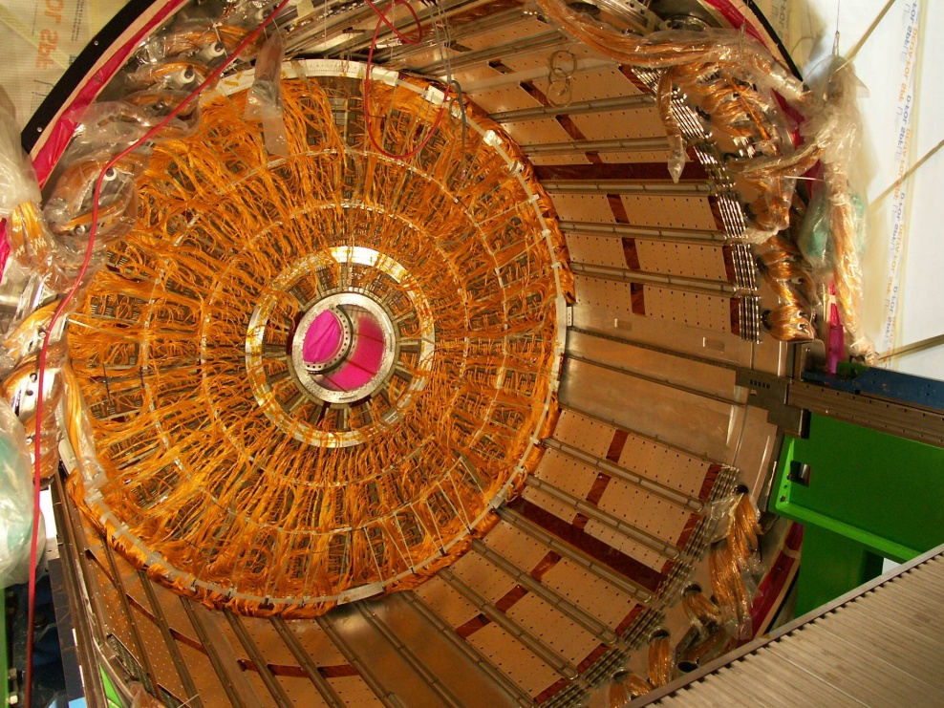
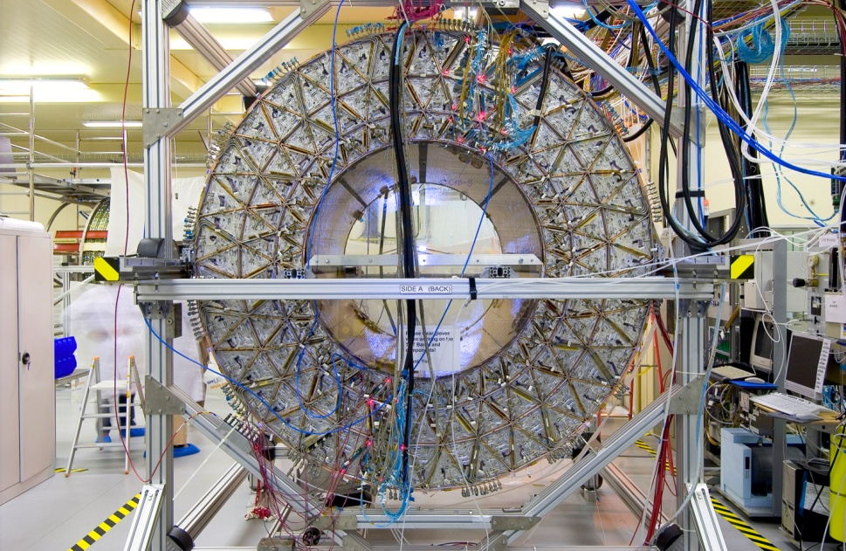
A signature-based search
The ATLAS detector
Electromagnetic calorimeter
Pixel detector
Inner detector
One EM barrel module
EM calorimeter end-cap
Transient radiation tracker
Silicone tracker detector

Slide 16
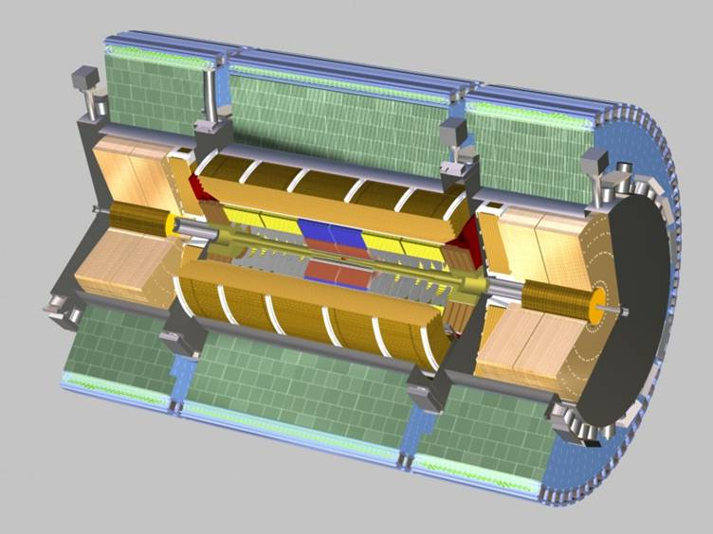
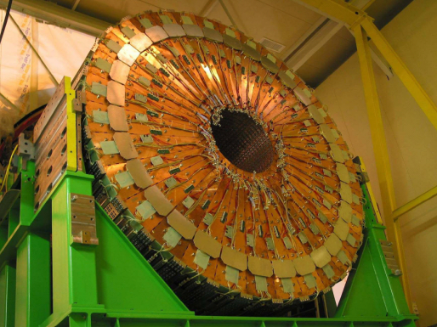
A signature-based search
The ATLAS detector
Hadronic end-cap
Hadronic Calorimeter
Tile calorimeter module
Forward calorimeter

Slide 17
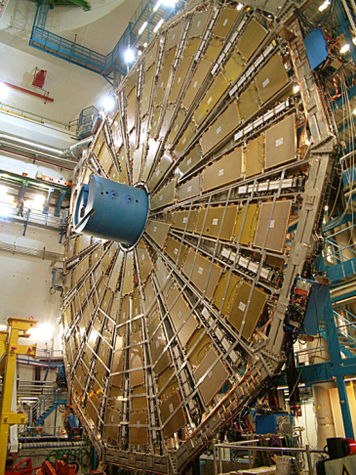
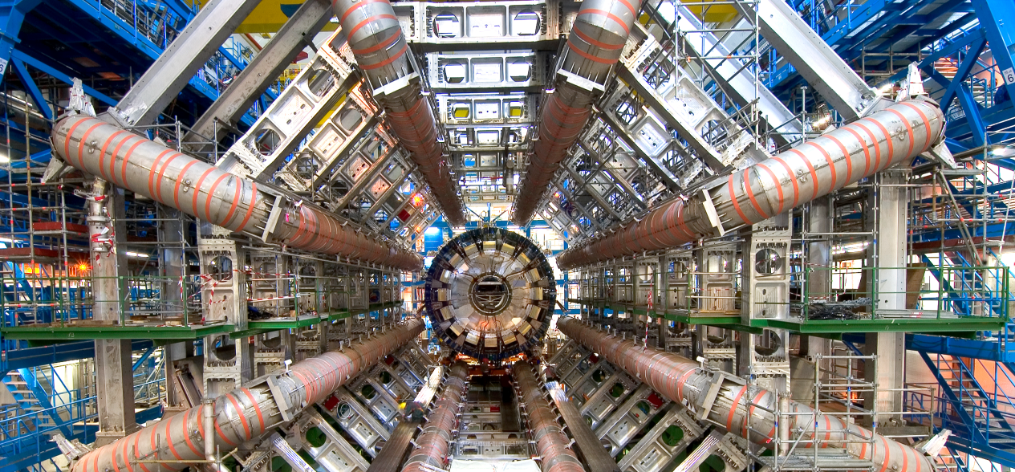
A signature-based search
The ATLAS detector
Muon spectrometer
Toroid magnet system

Slide 18
How to look for new phenomena?
3- Understand the ATLAS detector and rediscover the Standard Model

Slide 19
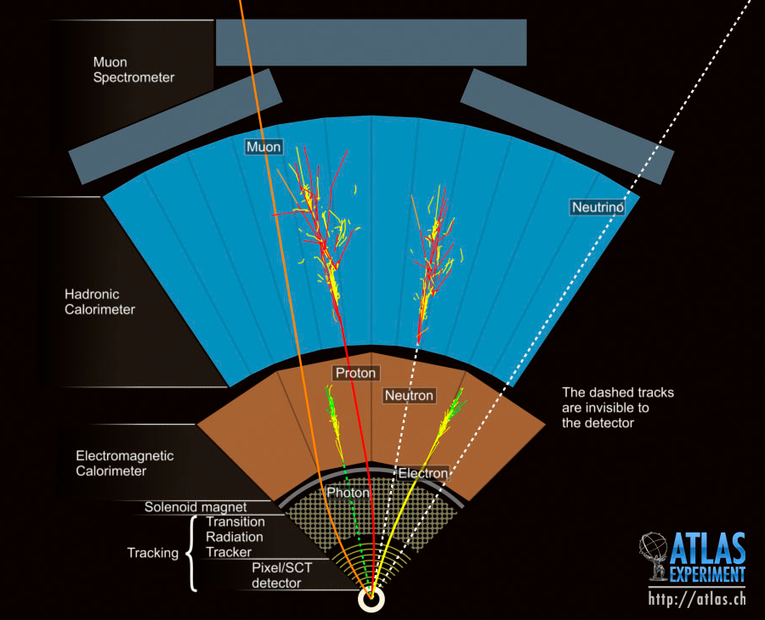
A signature-based search
Detecting known particles
Each known “stable” particle gives a distinctive signal in the detector
SM and new physics properties are inferred from kinematic studies of known particles
Missing
momentum
Jets
Muon
Electron

Slide 20
A signature-based search
Electrons and photons
Precise measurements of invariant masse of electron/photon pairs:
  detector response to electrons and photons well modelled by simulation
  the reconstruction and identification algorithms are efficient
Z⁰→e⁺e⁻

Slide 21
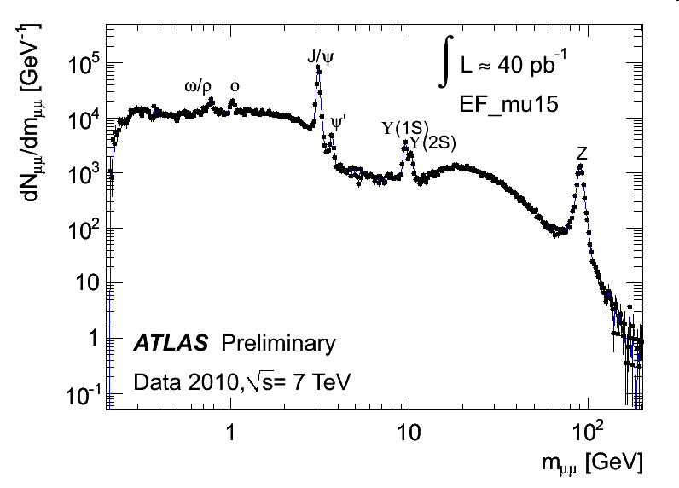
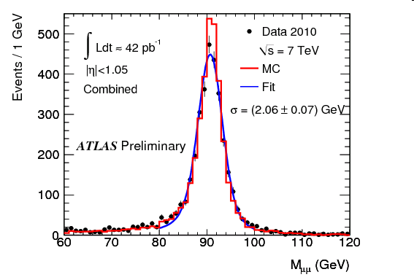
A signature-based search
Muons
In ATLAS has two distinct trackers to measure muons momentum
  Good momentum resolution for a large range of P_{T}
  Reduce background

Slide 22
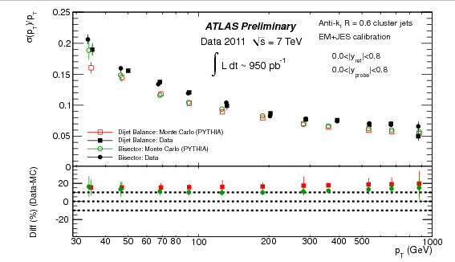
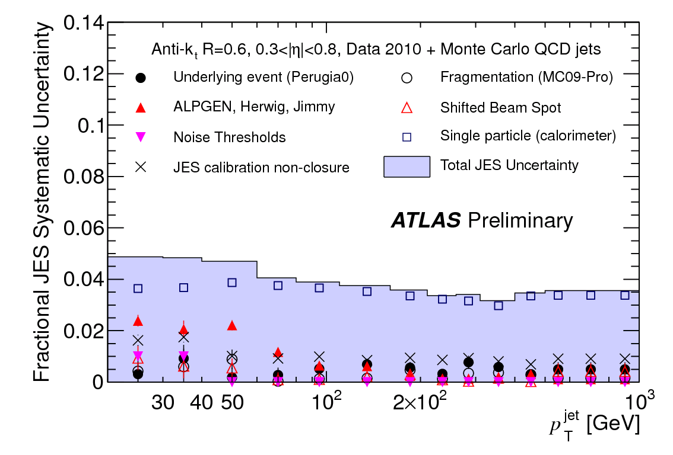
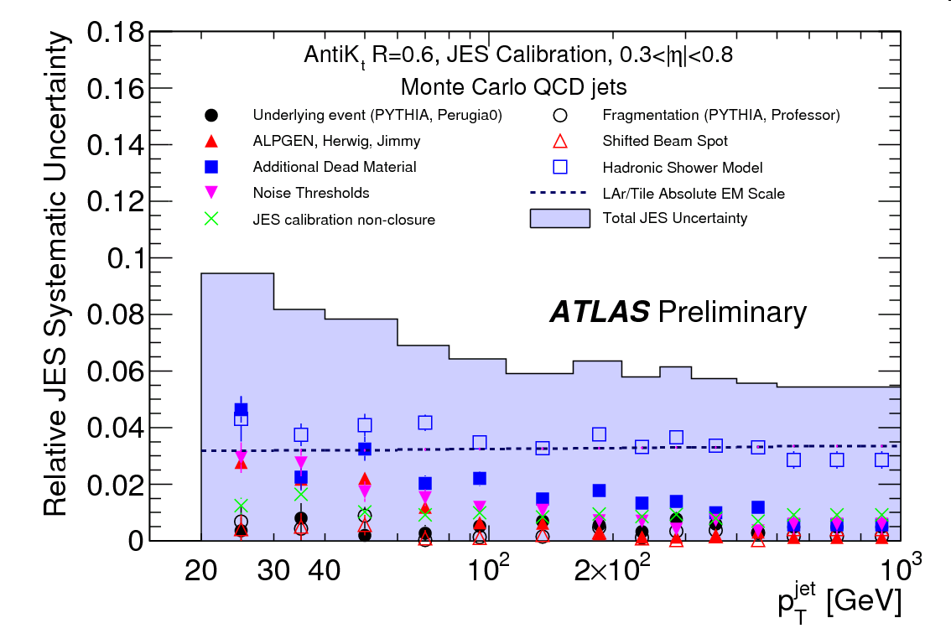
A signature-based search
Jets
Understanding jets means that simulation successfully describes:
  Jet Energy Resolution
    Calorimeter response to jets of
    hadrons
  Jet Energy Scale
    Difficult to calibrate jets
  ⇒ Largest systematic uncertainty
Jet energy scale obtained from MC
⇓
But uncertainty is constrained by single particle response, γ+jets, and Z+jets

Slide 23
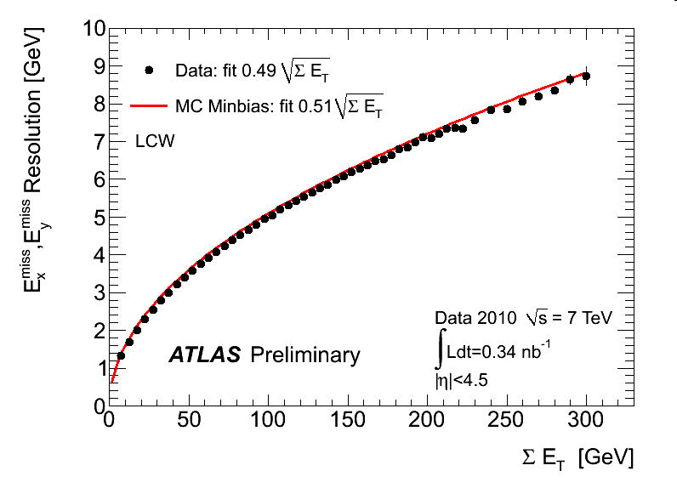
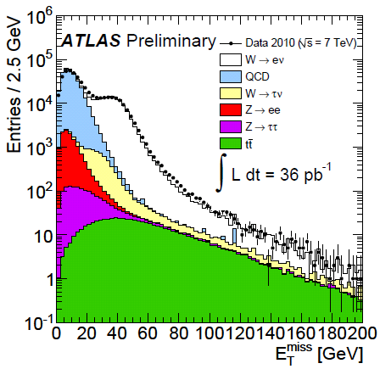
A signature-based search
Missing transverse energy
E_{T}^{miss} is a global quantity:
depends on the whole calorimeter energy depositions
  Good data to MC agreement = overall, calorimeter behaves as expected.
E_{T}^{miss} resolution
(minbias events)
E_{T}^{miss} distribution
(W→eν candidate events)

Slide 24
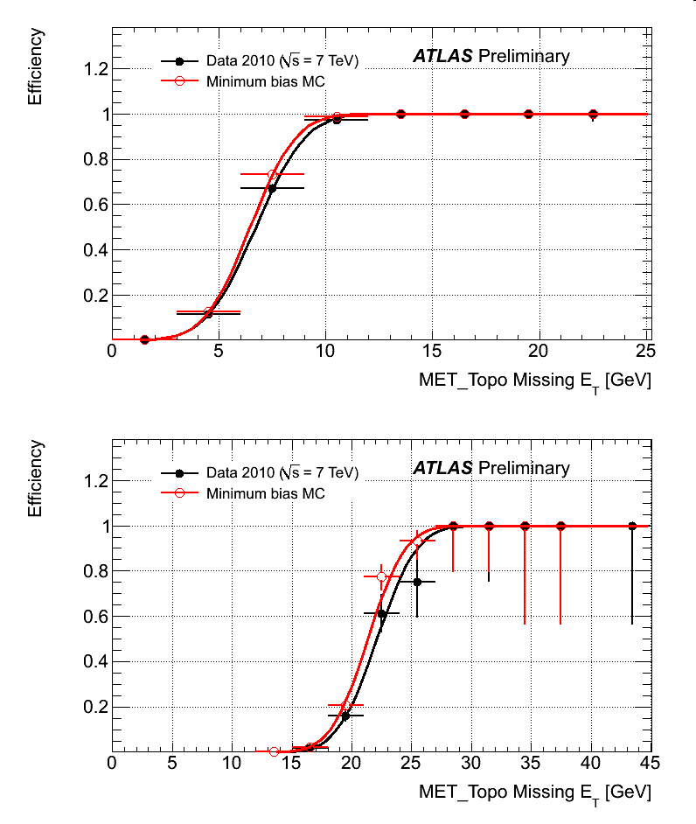
A signature-based search
Trigger
ATLAS can only keep ~0.005% of events yield in LHC collisions
  With luminosity of 1E33 cm⁻²s⁻¹ ≈ 100M events/second
  Can write on disk and process (Tier0) ~200-400 events/second
Challenging to trigger on monojet events
  Jets trigger rate impose really P_{T} threshold
  ➔ Use E_{T}^{miss} trigger!
    Well described in MC
    Trigger algorithm highly efficient

Slide 25
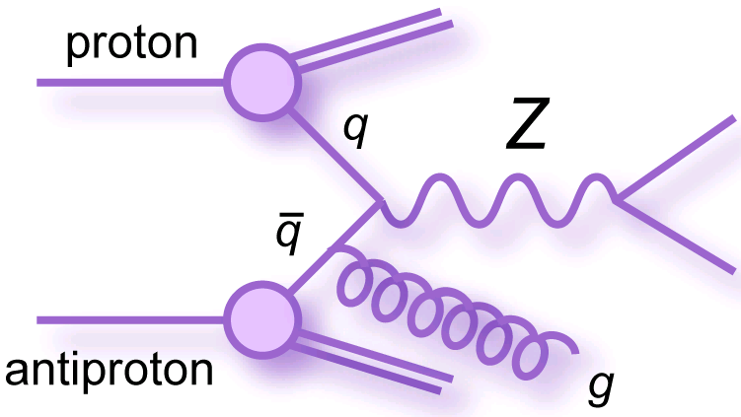
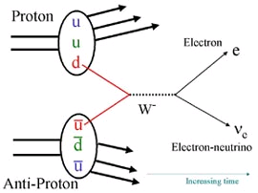
A signature-based search
W and Z events (I)
Now that we know that all individual ingredients needed for a measurement with the ATLAS detector are understood, lets see if this is enough for precise Standard Model measurements
⇒ Look at W and Z measurements
Z→μ⁺μ⁻ + jets
W→eν
Proton
μ⁻
μ⁺
Proton

Slide 26
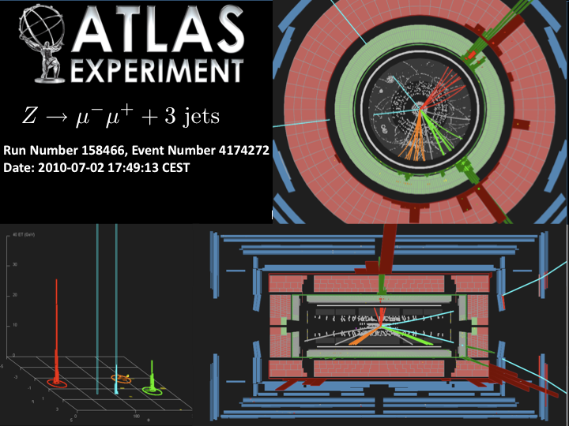
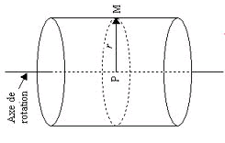
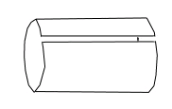
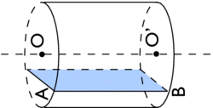
A signature-based search
W and Z events (II)
Muon
Jet
Muon
Jet
Jet

Slide 27
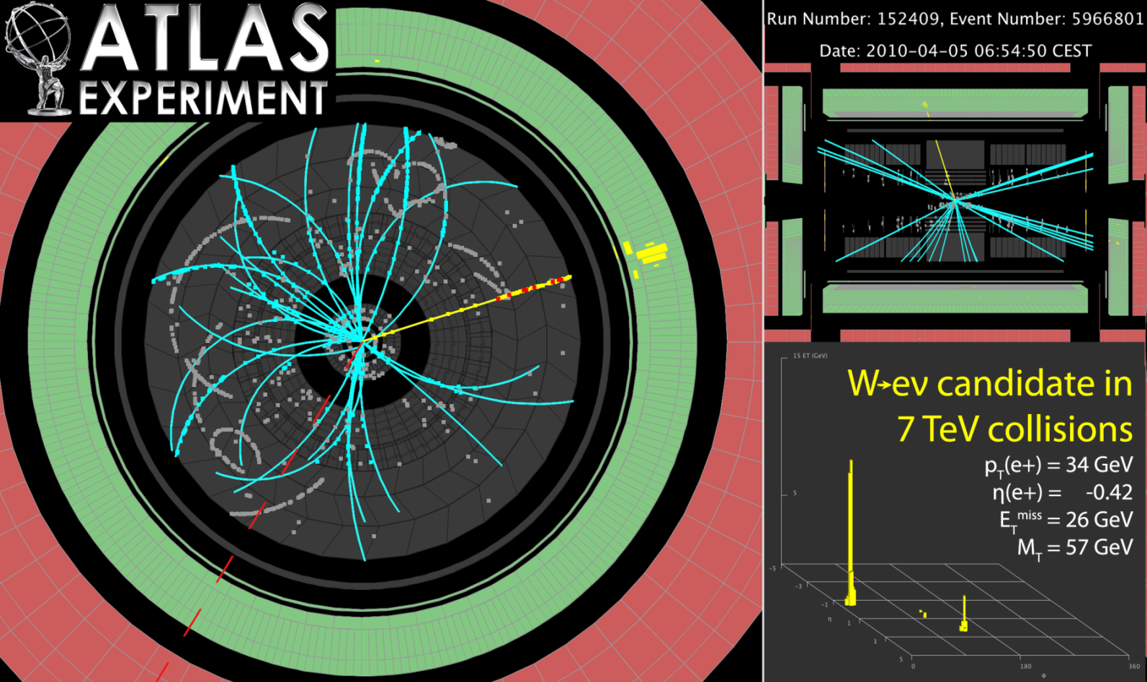
A signature-based search
W and Z events (III)
No real jets in this W→eν event
Electron
Large E_{T}^{miss} indicates neutrino

Slide 28
A signature-based search
W and Z measurements (I)
To have a good agreement between W and Z (differential) cross section measurements and theoretical predictions:
  Good description of detector response to jets, leptons and E_{T}^{miss}
  ► Unfolding
  Precise estimate of the lepton reconstruction and identification algorithms
  ► Efficiency estimates
  Good background predictions
  ► Data-driven estimate of QCD
  background to W→eν

Slide 29
A signature-based search
W and Z measurements (II)
W and Z total inclusive cross section measurements:
  Precision of the results depends on:
    Good estimate of the lepton reconstruction and identification efficiencies
    Good background predictions
σ
1.2% precision!
Reduce PDF uncertainty and
modify central value

Slide 30
A signature-based search
W and Z measurements (III)
W and Z P_{T} measurements:
  Precision of the results depends on stable unfolding of lepton momentum and hadronic recoil (E_{T}^{miss})
  Proper combination techniques
precision:
Z: 1.5%-5.4%
W: 1.9%-9.2%
Resummation important
even at high P_{T}
Multiple parton emission
Needed to model high P_{T}

Slide 31
A signature-based search
W and Z measurements (V)
W/Z+jets measurements:
  Need to understand jets
  Varying kinematic and event topology affect above results
Systematics at
the level of theory
uncertainty.
Limited by
uncertainty on
jet calibration
Need higher order corrections
Strong interaction similar in W and Z
31

Slide 32
A signature-based search
Rediscover Standard Model
ATLAS rediscovered the Standard Model with precision
These SM results can be used to find
new physics
More than a rediscovery of what we knew showing that the apparatus work well:
Extension of this knowledge to new regime
Improvement of overall understanding of SM

Slide 33
How to look for new phenomena?
4- Observe deviations with respect to Standard Model predictions

Slide 34

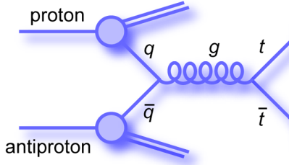
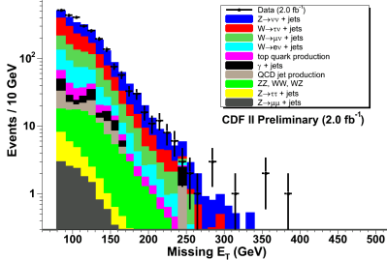
A signature-based search
The SM prediction
The simplest approach to look for deviations and find new physics is to perform counting experiments
To determine how many SM events should pass the selections defining the chosen final state (e.g. monojet):
⇒ predict production rate:
⇒ predict selection efficiency
and acceptance:
ν
q
+
THE KEY IS TO CONTROL
SYSTEMATIC UNCERTAINTIES
ν
q
Irreducible bkg.
reducible bkg.
understand
distributions
with detector
effects
➔
The sensitivity to new phenomena depends on:
  The relative amount of new physics and SM contribution
  The systematic uncertainty on the SM expectations

Slide 35

A signature-based search
Monte Carlo based estimate
Use theory / simulations to estimate production rate and model detector effects on efficiency of events selections
⇒ Systematic uncertainty from approximation and
inaccuracy in modeling of:
  Jet and E_{T}^{miss} energy scale and resolution
  Lepton energy scale and resolution
  ISR/FSR effects
  Fragmentation/hadronization
  Underlying events
  Parton Distribution Function
  Trigger, Pile up and luminosity
  Matrix Element calculation

Slide 36




A signature-based search
Data-driven technique 101 (I)
Reduce systematic uncertainty by replacing MC distribution with well understood data distribution similar to the process of interest to avoid bias
e⁻
ν
e⁺
ν
Stat error only
Simulation
Data
ν
ν

Slide 37
Data-driven techniques 101 (II)
In practice, to produce a data-driven predictions, we can:
  1- Reverse one (few) signal selection(s)
    Avoid signal contamination
Set of selections defining
signal (eg: monojet)
All events from a dataset
Event cut 1
Event cut 2
…
Event cut N-1
Event cut N
Y:
All other
selections
Data model
of the signal
Signal
events
Selections
to reverse
Y
X:
Z ⊆ ¬X
X
  2- Count the number of events in the Y∧Z (Z ⊆ ¬X) sample
  3- Compute the mapping factor giving the right normalization
If X is unbiased with respect to Y,
then Y∧Z provides a good model for Y∧X

Slide 38
Data-driven estimate of backgrounds in monojet events

Slide 39
SM background to Monojet events
Electroweak background:
  Z→νν + jets (largest and irreducible background)
  W → lν + jets where the lepton is not observed in the detector
  In this case, the reversed cut X is the lepton veto
QCD:
  E_{T}^{miss} originating from mismeasured jet energies
In this case, the reverse cut X is the number of jets in the event
We can use Z → ll + jets and W → lν + jets events with
reconstructed leptons to estimate these backgrounds
Estimated using multi-jet events in which E_{T}^{miss} points
along the direction of one of the jets

Slide 40

Electroweak bkg estimate (I)
Jets observables present similar distributions
Z→νν + 1-jet
e
Z→ee + 1-jet
Met
e
Before being used for a prediction, such distribution must be properly normalized
E_{T}^{miss} can similarly be obtained after
removing the two charged leptons
with corrections

Slide 41
Electroweak bkg estimate (II)
The data-driven prediction for the Z→νν+1-jet contribution to monojet events is obtained from the number of Z→ll+1-jet events passing jet and E_{T}^{miss} selections (N_{cand}), corrected for:
  Lepton acceptance (A_{lep}): area outside trackers
  Lepton efficiency (ε_{lep}): failure to identify the lepton
  Background (N_{bkg}): non Z→ll+1-jets events included in N_{cand}
  Difference in Z→νν and Z→ll branching ratio:
  Electron removal correction (A_{corr} )
From theory

Slide 42
Electroweak bkg estimate (III)
Similarly, W→lν + jets with a well reconstructed lepton are used to estimate the W+jets background to monojet events
  Need to estimate the probability to survive to lepton veto
From MC
(only a ratio!)
* Obtain independent predictions from electrons and muons

Slide 43

Electroweak backgrounds (IV)
Can also estimate of Z→νν + jets background from high statistics W→lν + jets events
  Use the theoretical prediction for
  Experimental systematic small (p30)
⇒ 4 statistically independent predictions for the Z→νν + jets
background!
Calculations performed at NLO (MCFM program)
  Uncertainty much smaller on R (ratio) than on individual cross sections

Slide 44

QCD backgrounds (I)
Sources of QCD contribution:
  2-jets events for which one of the jets is lost (dominate)
  3-jets events for which two jets are lost (smaller) → obtained
  from MC
To estimate the 2-jets contribution:
1- Select 2-jets events with E_{T}^{miss} toward the less energetic jet
2- Extrapolate 2nd jet E_{T} below energy threshold (loose a jet)
3- Background prediction
=
area under the fit in the extrapolated region
2-jets events
_{Extrapolated}
_{region}

Slide 45
The results: search for new physics with monojet events

Slide 46


Example of monojet event (I)
Appears to be good single jet plus Met event

Slide 47



Example of monojet event (II)
Muon
Tracking views clearly indicate that jet originates from cosmic ray which passes far away from overlapping collision vertex

Slide 48


Most Energetic Monojet Event
Jet E_{T} = 419 GeV, Missing E_{T} = 417 GeV

Slide 49

Not the most energetic event
Jet E_{T} = 602 GeV, Missing E_{T} = 523 GeV

Slide 50

CDF Monojet Results
Jet P_{T} / E_{T}^{miss} selections
Background | 80/80 | 150/120 | 180/150
Z→νν + jet | 3203 ± 137 | 390 ± 30 | 141 ± 17
W→τν + jet | 2010 ± 69 | 187 ± 14 | 58 ± 5
W→μν + jet | 1570 ± 54 | 117 ± 9 | 35 ± 3
W→eν + jet | 824 ± 28 | 58 ± 4 | 18 ± 2
Z→ll + jet | 87 ± 3 | 6 ± 1 | 2 ± 0
QCD | 708 ± 146 | 23 ± 20 | 12 ± 12
γ + jet | 209 ± 41 | 17 ± 5 | 8 ± 3
Non-collision | 52 ± 52 | 10 ± 10 | 3 ± 3
Predicted | 8663 ± 332 | 808 ± 62 | 277 ± 30
Observed | 8449 | 809 | 319
Outstanding precision of
<4% on SM prediction
Tight constrains on
extra dimension models
⇒
Results are consistent with SM regardless
of the jet P_{T} and E_{T}^{miss} selections

Slide 51

Monojet events selections
CDF Limits on Large Extra Dimensions
Limits on the 4+n dimensional Planck scale M_{D} and on the radius R of the extra dimensions
n | M_{D} (TeV) | R (mm)
2 | > 1.33 | < 2.7 E-01
3 | > 1.09 | < 3.1 E-06
4 | > 0.99 | < 9.9 E-09
5 | > 0.92 | < 3.2 E-10
6 | > 0.88 | < 3.1 E-11
Eöt-Wash limit: R < 1.3 × 10⁻¹ mm (n=2)

Slide 52

Monojet events selections
ATLAS Limits on Large Extra Dimensions
Best limits of the world!

Slide 53
Monojet events selections
Perform a SM measurement too!
The precision of the lowest kinematic region is ~3.8%
⇒ can measure N_{ν}, Γ_{Z}(inv)!
LEP: 2 types of measurements
  Indirect: lineshape → really precise
  Direct: γ+Met topology → less precise
At hadron colliders:
  Expect similar sensitivity to LEP direct
  Even fewer theoretical inputs
  Completely independent of LEP measurements
Background | 80/80
Z→νν + jet | 3203 ± 137
W→τν + jet | 2010 ± 69
W→μν + jet | 1570 ± 54
W→eν + jet | 824 ± 28
Z→ll + jet | 87 ± 3
QCD | 708 ± 146
γ + jet | 209 ± 41
Non-collision | 52 ± 52
Predicted | 8663 ± 332
Observed | 8449

Slide 54
Monojet events selections
Invisible width of the Z⁰
Γ_{Z}(inv) = 466 ± 14 ± 40 MeV
Experiment | Γ_{Z}(inv) MeV | N_{ν}
CDF | 466 ± 42 | 2.78 ± 0.26
L3 | 498 ± 17 | 2.98 ± 0.06
OPAL | 539 ± 31 | 2.69 ± 0.17
ALEPH | 450 ± 48 | 2.86 ± 0.09
DELPHI | --- | 2.84 ± 0.21
LEP comb. | 503 ± 16 | 2.92 ± 0.06
LEP indirect | 499.0 ± 1.5 | 2.984 ± 0.008
Comparing this value with SM expectation gives the number of light ν types:
N_{ν} = 2.78 ± 0.08 ± 0.25

Slide 55
CONCLUSION

Slide 56
The LHC delivered a sufficient amount of data in 2010-11 for
  a good understanding of the ATLAS detector
  a better understanding of many aspects of the Standard Model.
These Standard Model measurements can then be used to make background predictions for new physics searches
  Data-driven background estimates improve the sensitivity to new physics by keeping systematic uncertainties low
Techniques specific to searches for new physics in jets+E_{T}^{miss} events have been developped
  Limits on monojet events constrain Large Extra Dimensions models
  Already beats all previous limits at the LHC
We are now surfing in new territory!

Slide 57
BACK UP

Slide 58

A signature-based search
Extra Dimensions
Proposed (late 90’s) as an ingredient to solve the hierarchy problem
  also used in solutions to other problems leading to BSM models
    EWSB, Dark Matter, Dark Energy, etc...
⇒ Rich idea justifying searches for
experimental evidences of ED
ED must be somehow hidden or we would have already observed them
  compactified with radius R
In the ADD scenario, only gravity can access the extra dimensions
⇒ Scenario considered in the following

Slide 59





A signature-based search
Gravity in Large Extra Dimensions
Gravitational potential in 3D
(Newton)
Gravitational potential in 3+n
Spatial dimensions
(compactified at radius R)
R< R:
r > R:
If R >> M_{D}⁻¹: gravity is, fundamentally, as strong as the Weak
Interactions, but get diluted in large extra dimensions

Slide 60
A signature-based search
Graviton in hadron colliders
Gravity interacts with all particles
  Direct production of graviton’s
  Kaluza-Klein (kk) modes
Production rate can be high:
  Experiments happen in 4D
  ⇒ probability of graviton ∝ 1/M_{Pl}²
  Any kk graviton can be produced
  ⇒ Sum over all possible kk-modes:
  density of states = (M_{Pl}²/M_{D}^{n+2}) m^{n-1}Δm
  ⇒ production rate ∝ 1/M_{D}^{n+2} >> 1/M_{Pl}²
The produced gravitons escape detection
Signature : 1 jet + unbalanced momentum (E_{T}^{miss})

